Slide 1
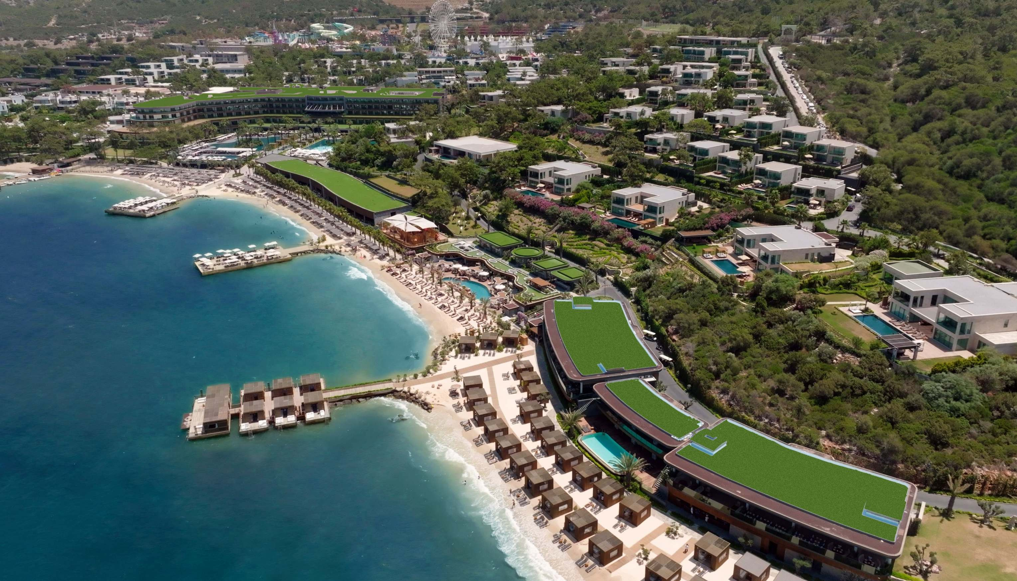
2025
factsheet
MEMBER OF
M A C E H OT E L S

Slide 2
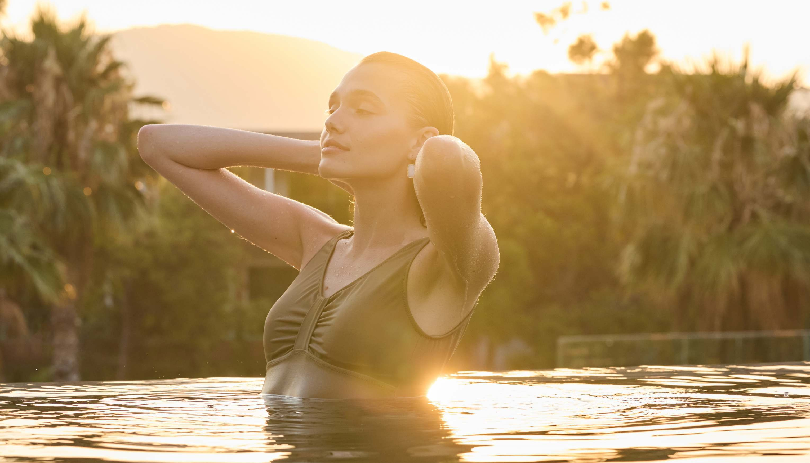
Bodrum-Milas Airport꞉ 27 km / Approximately 25 min by car
Nearest City Centre꞉ 10 km (Bodrum) Transportation꞉ Concierge / Local Bus / Taxi Suitable for disabled guest꞉ Yes
Smoking꞉ Is not allowed in rooms, kids areas, indoor areas
Location and Lenght of Beach꞉ 600 m sandy private beach with 2 piers & 100 m VIP sandy beach with 1 VIP pier Blue Flag
Check-In/Check-Out꞉ 14꞉00 - 12꞉00
Spoken Lnguages꞉ Turkish, English, German, Russian Accepted Credit Cards꞉ Visa, Mastercard, Amex Currency Exchange꞉ Available
voguehotelsupreme.com

Slide 3
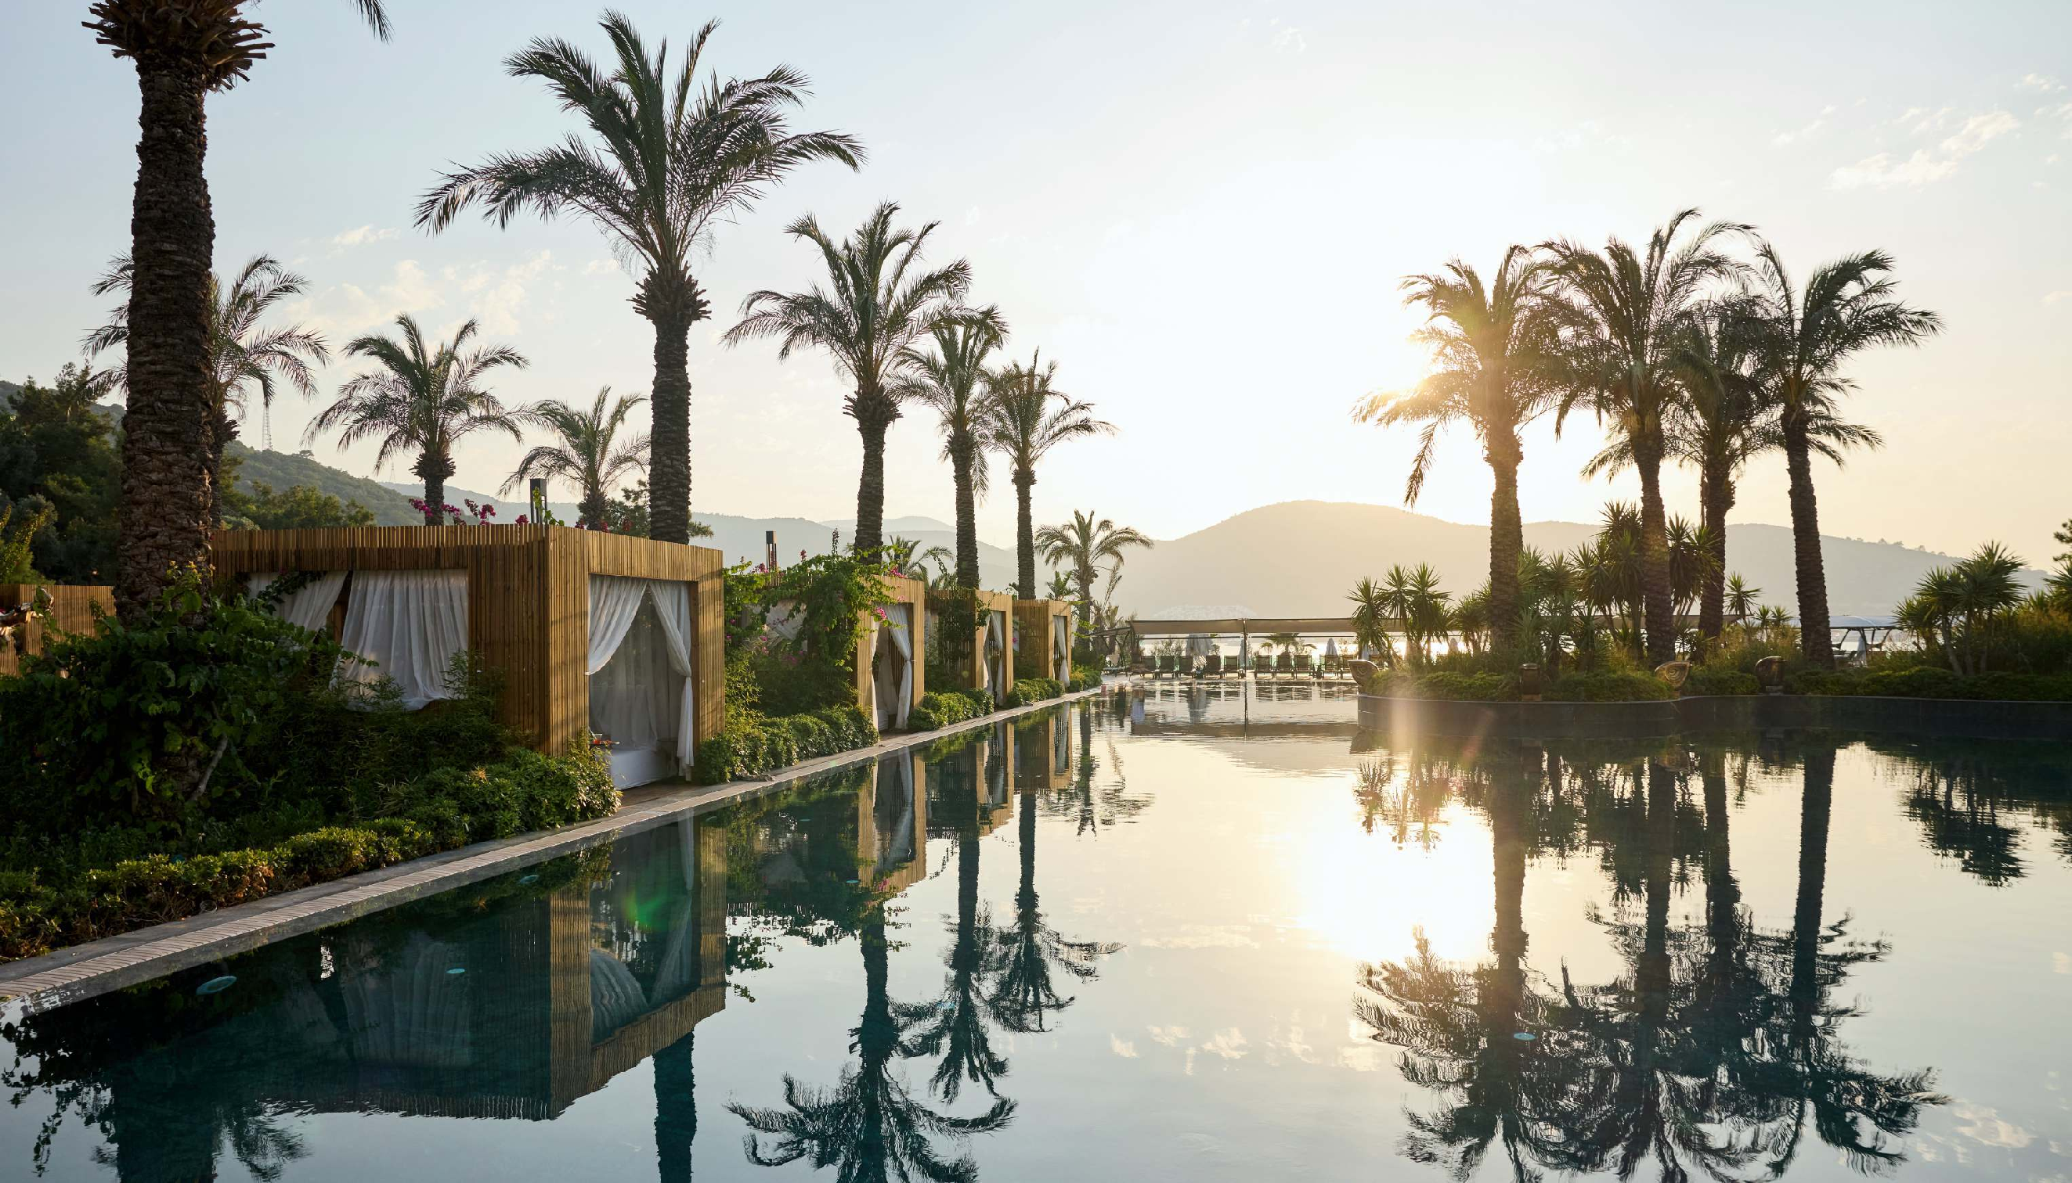
general
information
Opening Date꞉ 2013
Official Category꞉ 5 Star Hotel
Last Renovation꞉ 2024
Address꞉ Torba, Usuluk Sok. No꞉10 BODRUM
Concept꞉ Ultra All Inclusive
Total Area꞉ 400.000 m2
Total number of Rooms꞉ 730 Rooms, 52 Private Villas
Total number of Beds꞉ 2210
Number of Floors꞉ 5 Floor Main Building
Summer Season꞉ 28 March- 30 October

Slide 4
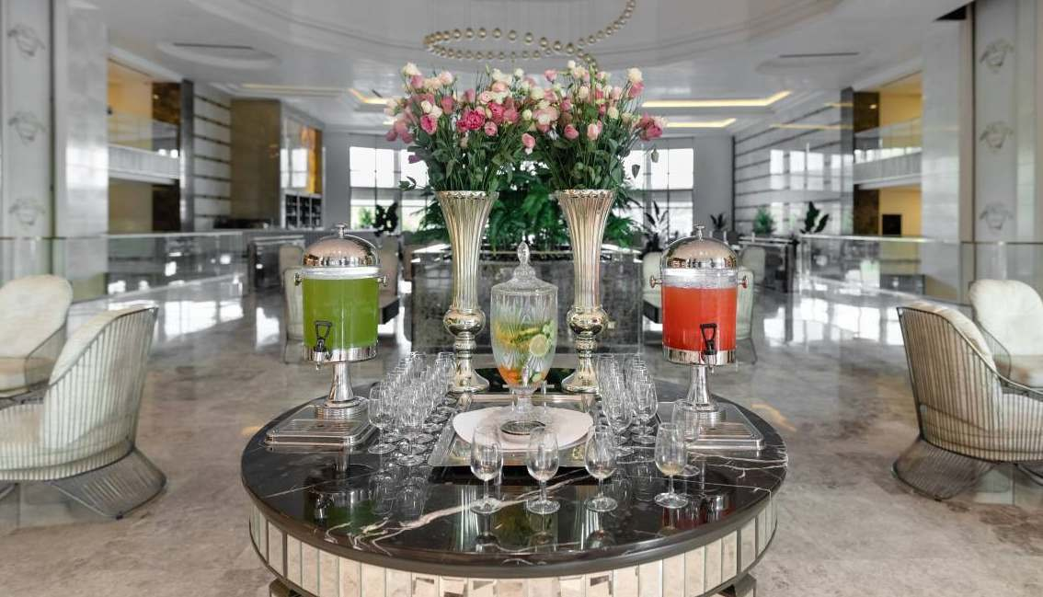
wellco_{f}m_{ar}in_{e}g_{we}
General briefing about the hotel amenities Check-In procedures are made with Turkısh delight and dried fruits between 08꞉00 - 20꞉00. valet and
bellboy services are available7/24. Water and various treats at farewell

Slide 5
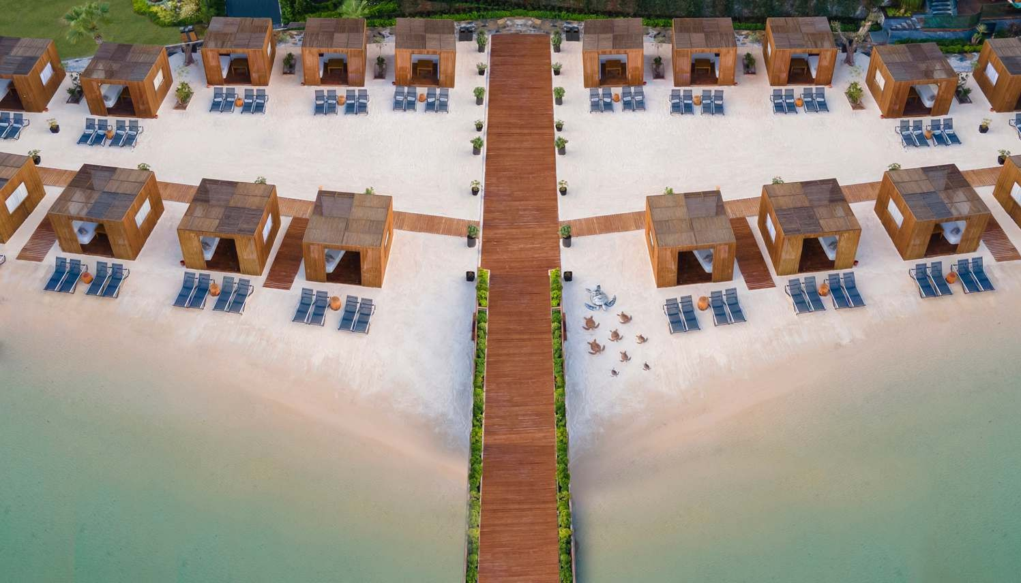
Private beach 750 m total length fully covered with white sand 100 m VIP private beach with pavilions for
rent for guests staying at the villas 4 Piers in total, one of which with pavilions for rent
beachs &
pavilions
FOR RESERVATIONS
Guest Relations

Slide 6
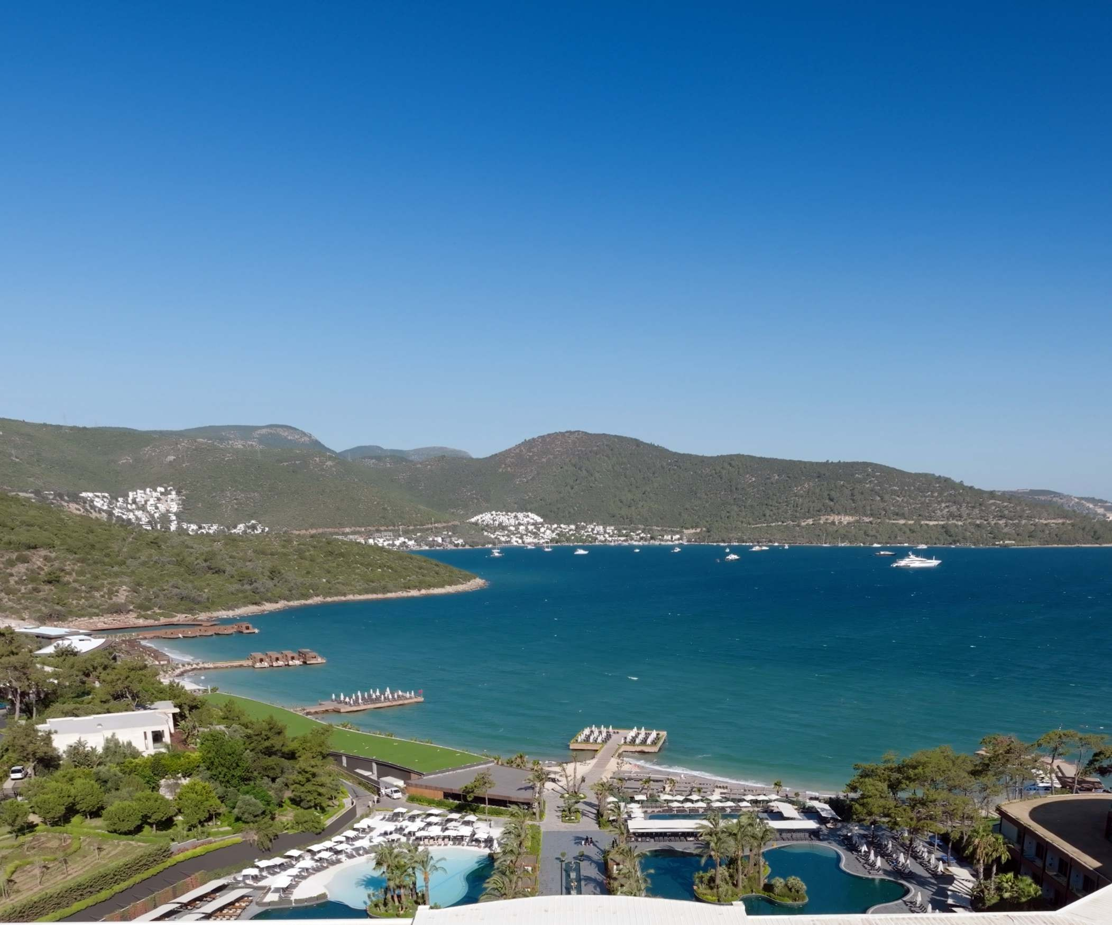
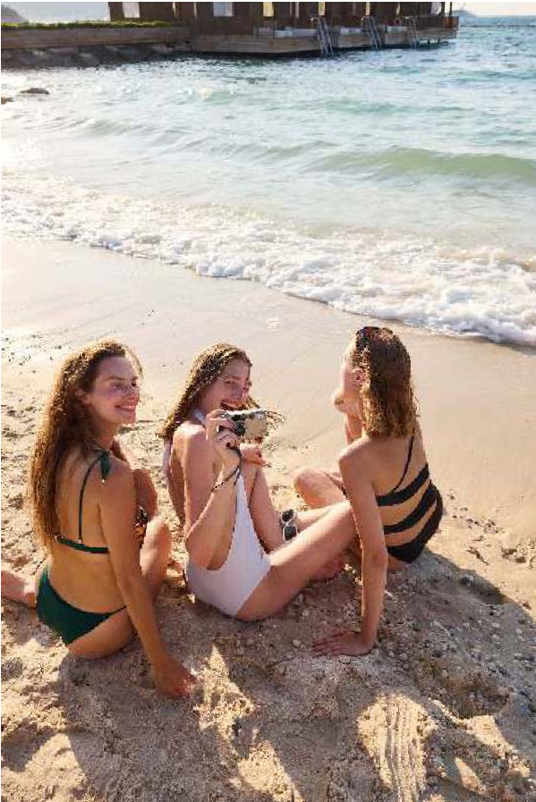
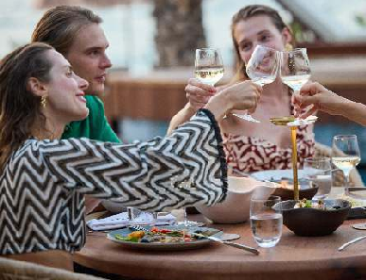
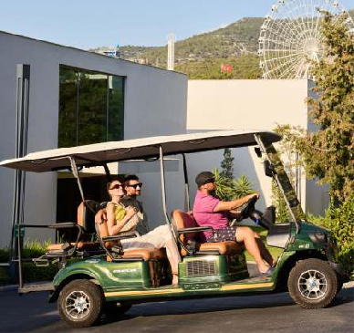
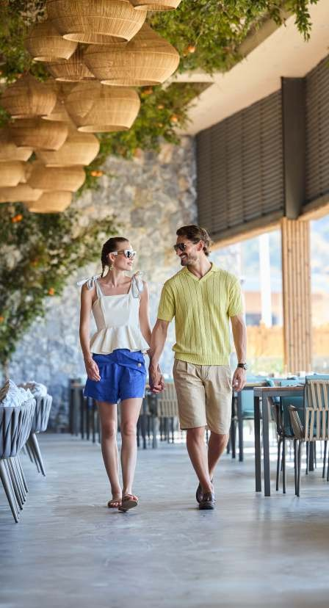
free
services & facilities
extra
Laundry Service, Telephone-Fax, Photographer, Massage & Treatments, Babysitting Service, Shisha, Watersports, Hairdresser, Meeting Rooms Pavilions on the beach, Private Tennis lessons
Internet / Wireless,
Birthday & Anniversary amenities, In the room
Honeymoon Package Valet Service
Beach and Pool Towels Sunbeds & Umbrellas Turkish Bath & Sauna Candytown & Candyland Use Disco and Activities
extra
Wheel chair rent Rent a Car
Nurse & Doctor Service Shopping Arcade Butler Service
Room Service 24H/7 Private Transfers Event organizations Private Yacht Tours Tour organizations Baby Stroller
Indoor parking

Slide 7
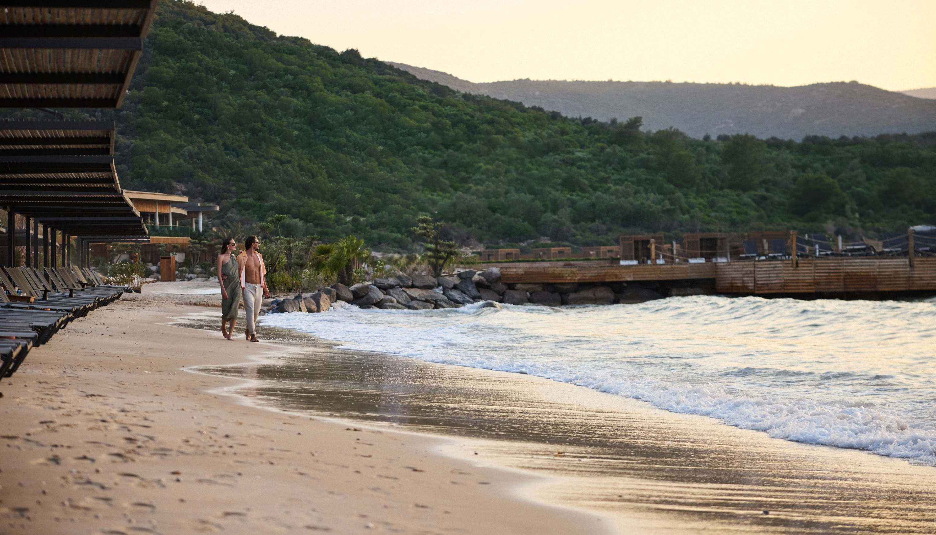
Free of charge honeymoonBirthday & Anniversary Offers
Fruitplate, wine & cake service;
priority for booking of a la carte restaurants Atarrivalday꞉ fruitbasket, chocolate plate & bottle of sparkling wine to the room a romantic dinner at the a la carte restaurant
Honeymoon breakfast once in the room One time Photo shoot
15% SPA discount

Slide 8
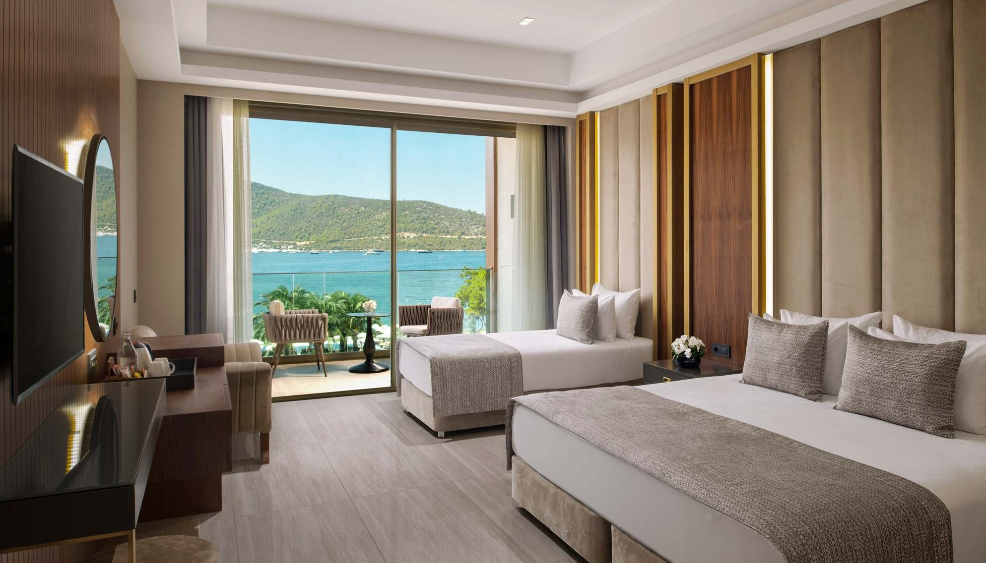
Rooms

Slide 9
ROOM FACILITIES | GARDEN ROOM ANNEX | SUPERIOR GARDEN ROOM ANNEX | SUPERIOR ROOM LAND VIEW | SUPERIOR ROOM SEA WIEV | CORNER DELUXE ROOM LAND VIEW | FAMILY GARDEN ROOM ANNEX | FAMILY CONNECTION ROOM ANNEX | FAMILY SUIT SEA VIEW | FAMILY SUIT LAND VIEW
Square Meters | 32 | 50‑55 | 50‑55 | 50‑55 | 75 | 75 | 90 | 75 | 75
Location | Bungalow | Bungalow | Main Building | Main Building | Main Building | Bungalow | Bungalow | Main Building | Main Building
Balcony
Seating Group (Balcony)
Floor Type | Marble | Marble | Ceramic | Ceramic | Ceramic | Marble | Marble | Ceramic | Ceramic
Sea View Rooms | x | x | x |  | x | x | x |  | x
Land View Rooms | x | x |  | x | ✓ | x | x | x | ✓
Garden View Rooms |  |  | x | x | x |  |  | x | x
Disabled Room | x |  |  | x | x | x | x | x | x
Bedroom | 1 | 1 | 1 | 1 | 1 | 2 | 2 | 2 | 2
Sofa | x
Dressing Room | x | x |  |  |  | x | x
Bathroom | 1 | 1 | 1 | 1 | 1 | 1 | 2 | 1 | 1
WC
Shower
Bathtub | x | x | x | x | x |  |  | x | x
Hairdryer
Bathroom Installation
(Shampoo, Conditioner, Shower Gel, Soap, Shower Bones, Cotton Swab)
O/R=onrequest Connection Room (90m2) consistsof 2 bedrooms and 2 bathrooms꞉ 1st.room꞉ french bed, separate door, bathroom and balcony, 2d.room꞉ 2 single beds, separate door, bathroom.

Slide 10
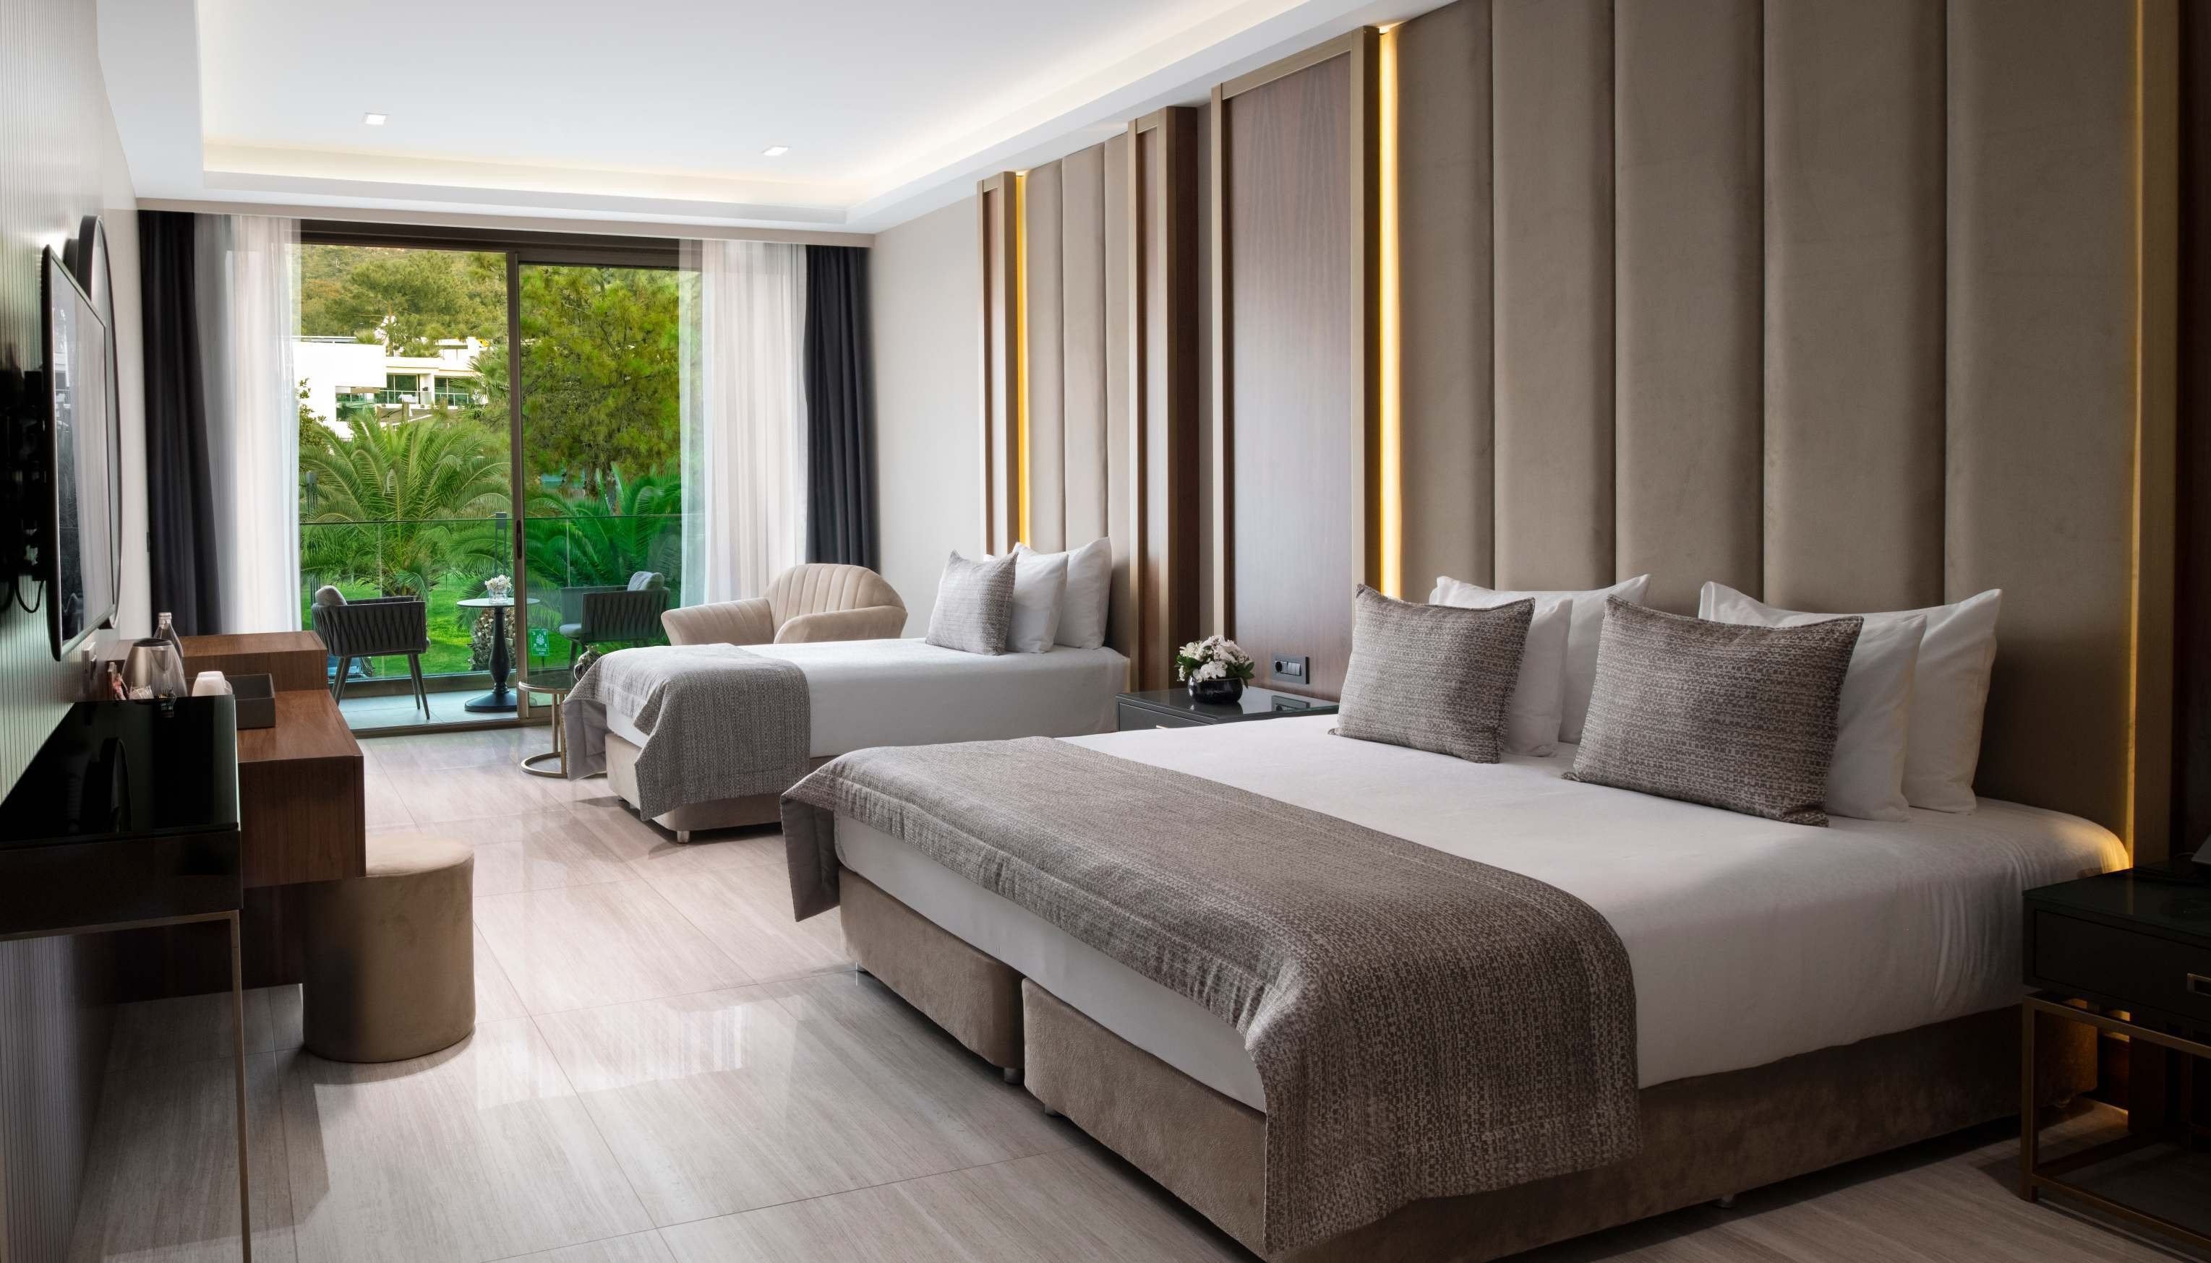

Slide 11
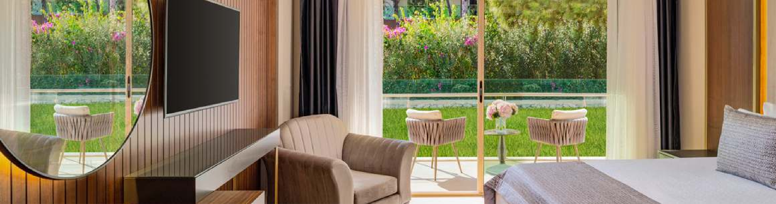
ROOM FACILITIES | GARDEN ROOM ANNEX | SUPERIOR GARDEN ROOM ANNEX | SUPERIOR ROOM LAND VIEW | SUPERIOR ROOM SEA WIEV | CORNER DELUXE ROOM LAND VIEW | FAMILY GARDEN ROOM ANNEX | FAMILY CONNECTION ROOM ANNEX | FAMILY SUIT SEA VIEW | FAMILY SUIT LAND VIEW
Slippers
Baby Cot | x | O/R | O/R | O/R | O/R | O/R | O/R | O/R | O/R
Bottle Warmer | O/R | O/R | O/R | O/R | O/R | O/R | O/R | O/R | O/R
Baby Bath / Potty
Digital Key System
Led Tv, Satellite HD
Broadcasting Of International Channels Telephone
Phone In the Bathroom Wi‑Fi
Central Air Conditioning Digital Safebox
Mini Bar (Filled Once A Day) Tea And Co ee Set Up & Kettle Dressing Mirror

Slide 12
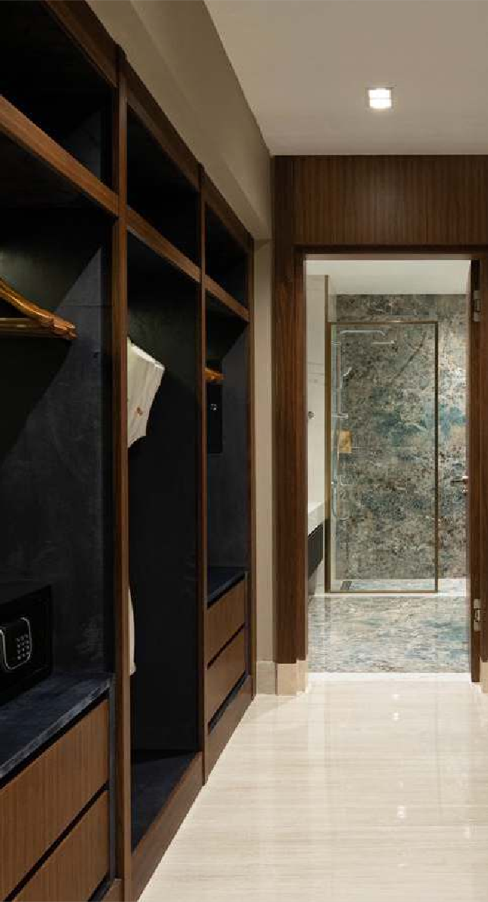
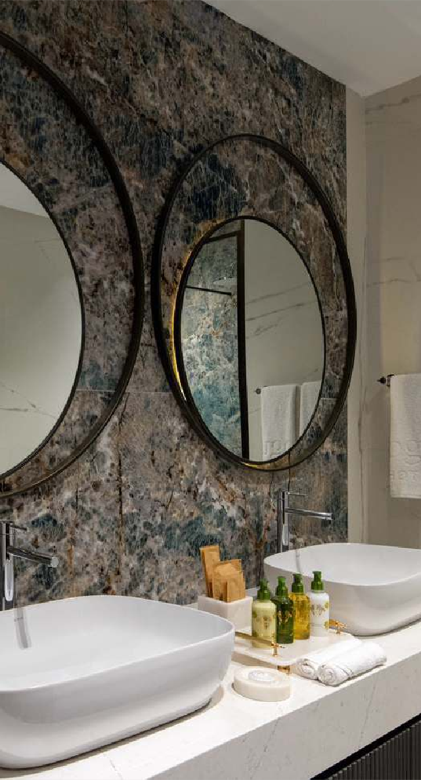
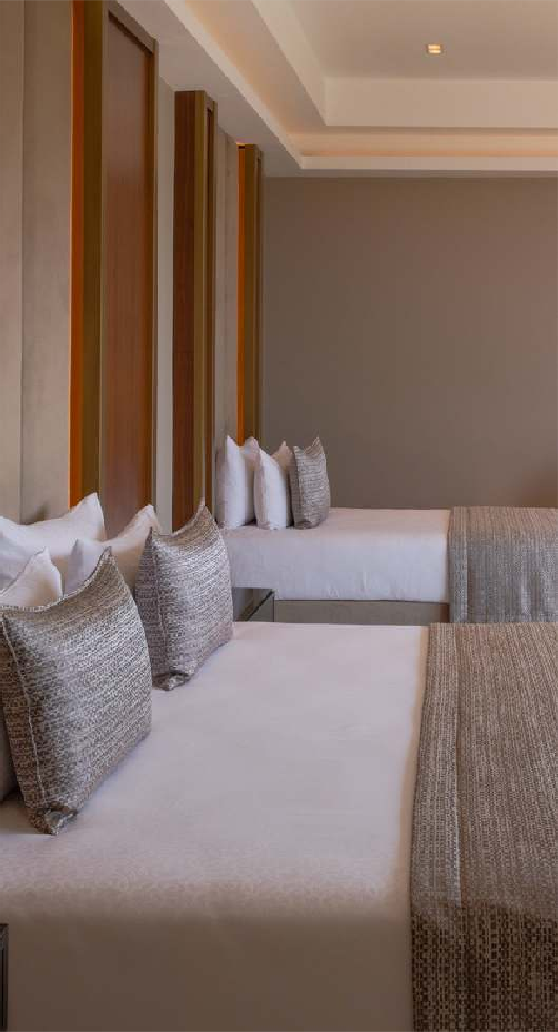
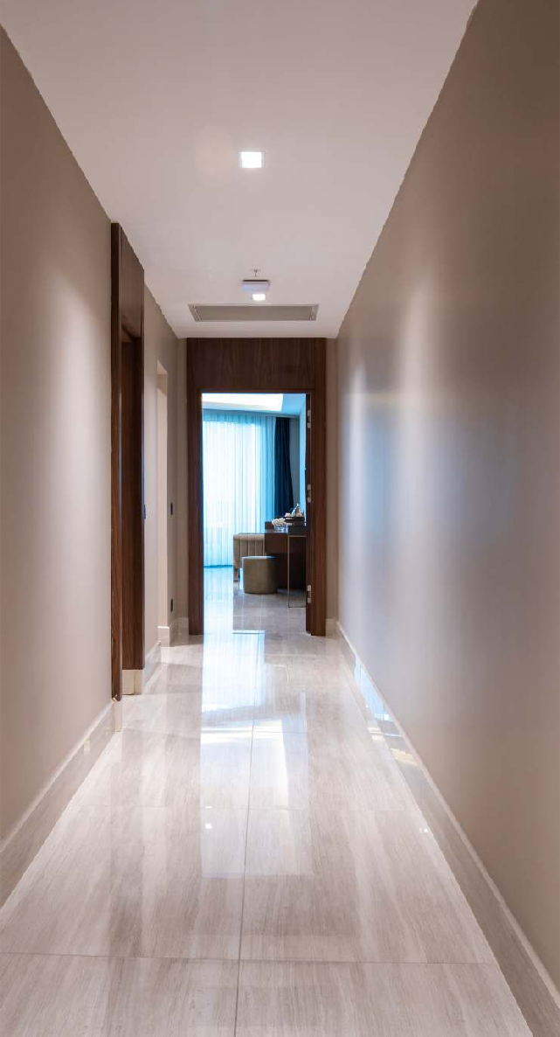

Slide 13
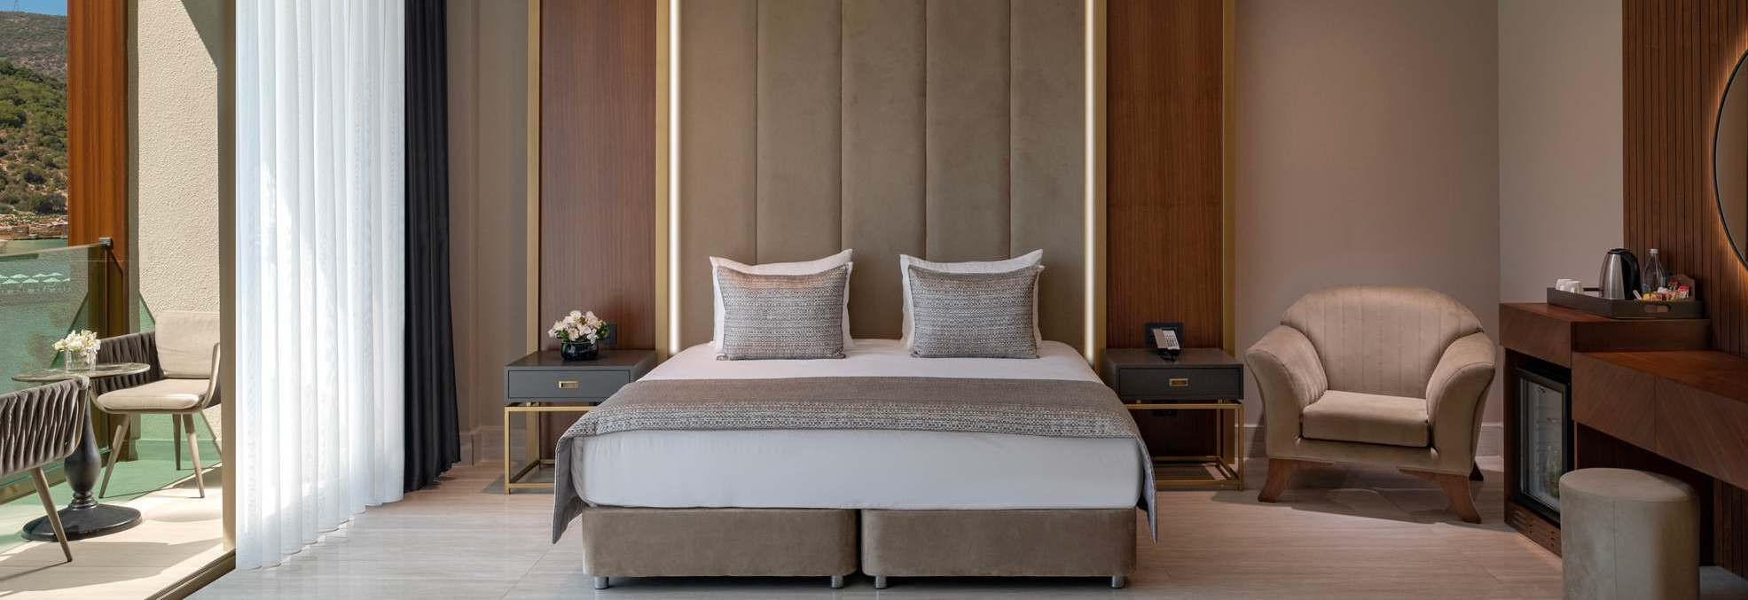
ROOM & SUITES FEATURES | LOCATION | TOTAL | SQUARE METER
Standart Garden Room Annex | Garden Area | 39 | 32
Handicapped Rooms | Main Building & Garden Area | 8 | 55
Superior Garden Annex | Garden Area | 227 | 55
Superior Land View | Main Building | 167 | 55
Superior Sea View | Main Building | 118 | 55
Corner Deluxe Room | Main Building | 19 | 75
Family Garden Room Annex | Garden Area | 37 | 75
Family Connection Room Annex | Garden Area | 88 | 90
Family Suite Land View | Main Building | 19 | 75
Family Suite Sea View | Main Building | 8 | 75

Slide 14
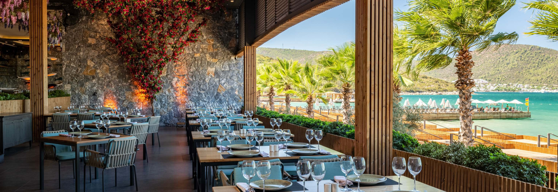
MAIN RESTAURANT | ALAC ARTE RESTAURANTS | SNACK RESTAURANTS | BARS | FOOD CORNERS
Open Bu et | PINSKY,BEACH LOUNGE | CANDYLAND | LOBBYBAR24/7 | Patisserie
Breakfast | 7/24NISK24 RESTORAN | SUNSET | CANDYLANDBAR | Fruits
Late Breakfast | LOCO, ITALIAN CUISINE |  | COFFEEHOUSE | Baked Potatoes & Hamburger
Lunch | RADIKA, TURKISH CUISINE |  | ARENANIGHTCLUB | Ice Cream
Dinner | MORALA, SEA FOODS |  | POOLBAR‑BEACHBAR | Turkish Pancake
 | TORANAGA,TEPPANYAKI |  | VITAMINBAR | Candyland Food Court Snack
Special Menu |  |  | VIPBAR
Gluten Free & Lactose Free |  |  | ALACARTEBAR
Baby Menu (O/R); |  |  | SERVICEBAR
Diet Bu et |  |  | CANDYTOWNBAR

Slide 15
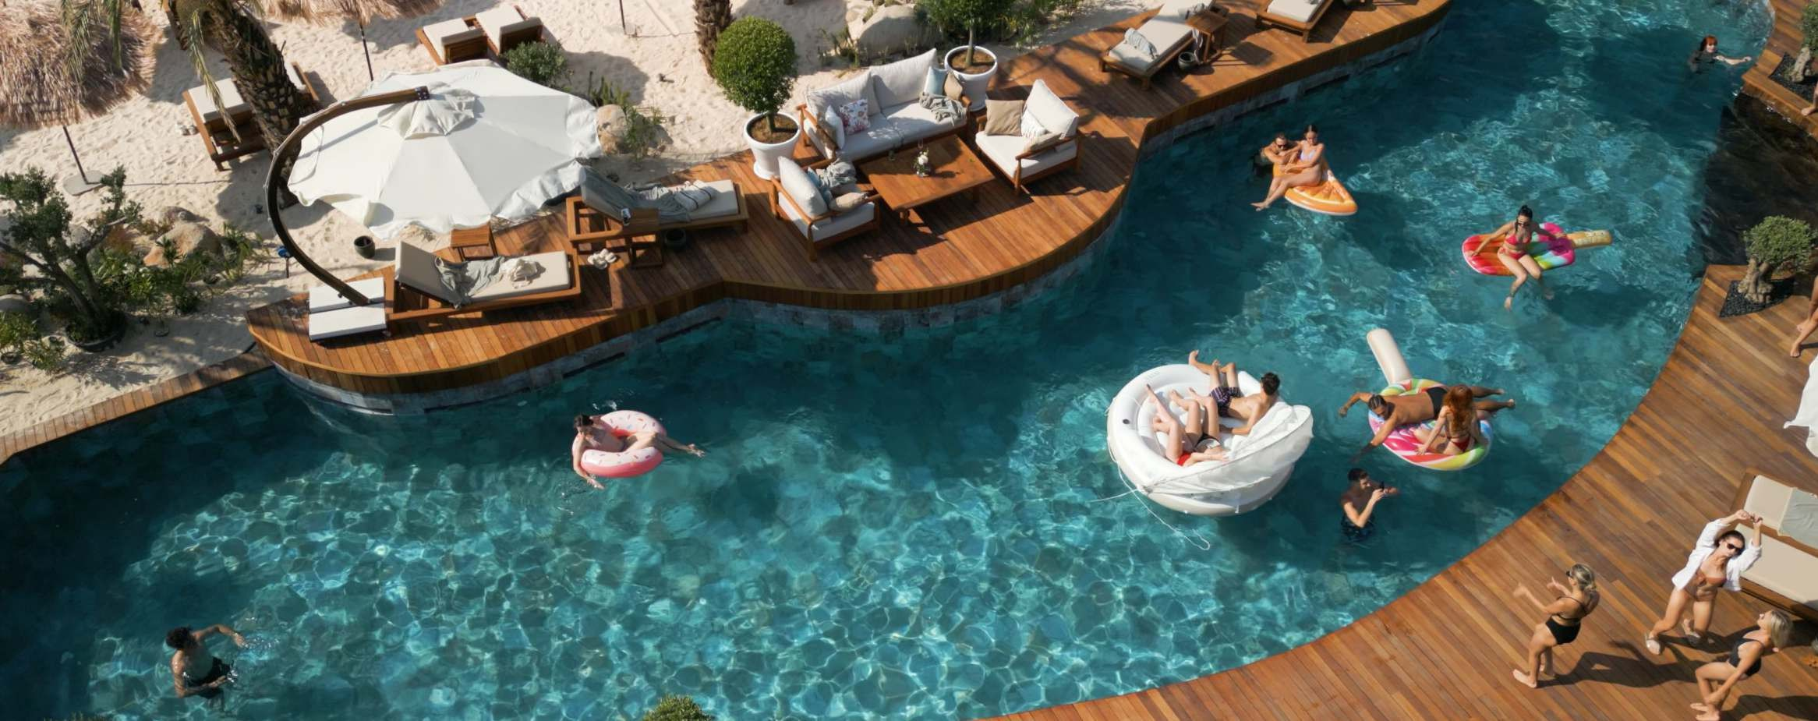
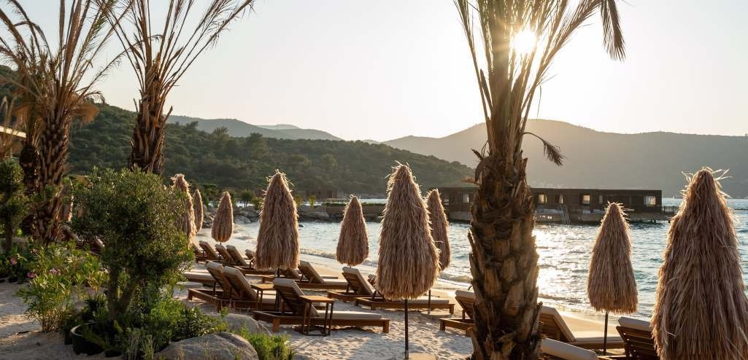
Opened In 2021 author's restaurant "Pinsky" on the Mediterranean coast shows the best that the Pinskiy & Co holding has꞉ the most popular dishes, high-quality service, and a fashionable modern interior. Dishes are waiting for you - the visiting card of the holding is the author's Pinsky roll with strawberries and avocado, chicken with Thai sauce and vegetables, a large green salad with avocado, cherry tomatoes and gamadari sauce, and much more.

Slide 16
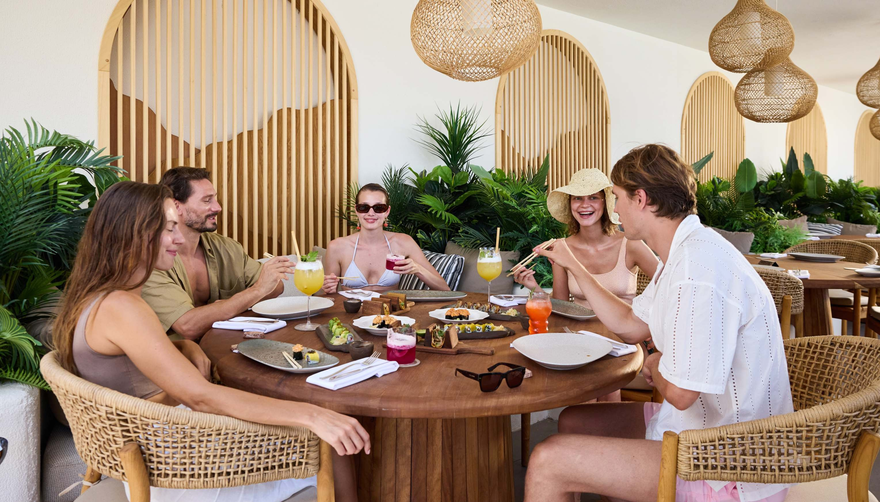
(with reservation) BREAKFAST, LUNCH, DINNER
Extra Charge

Slide 17
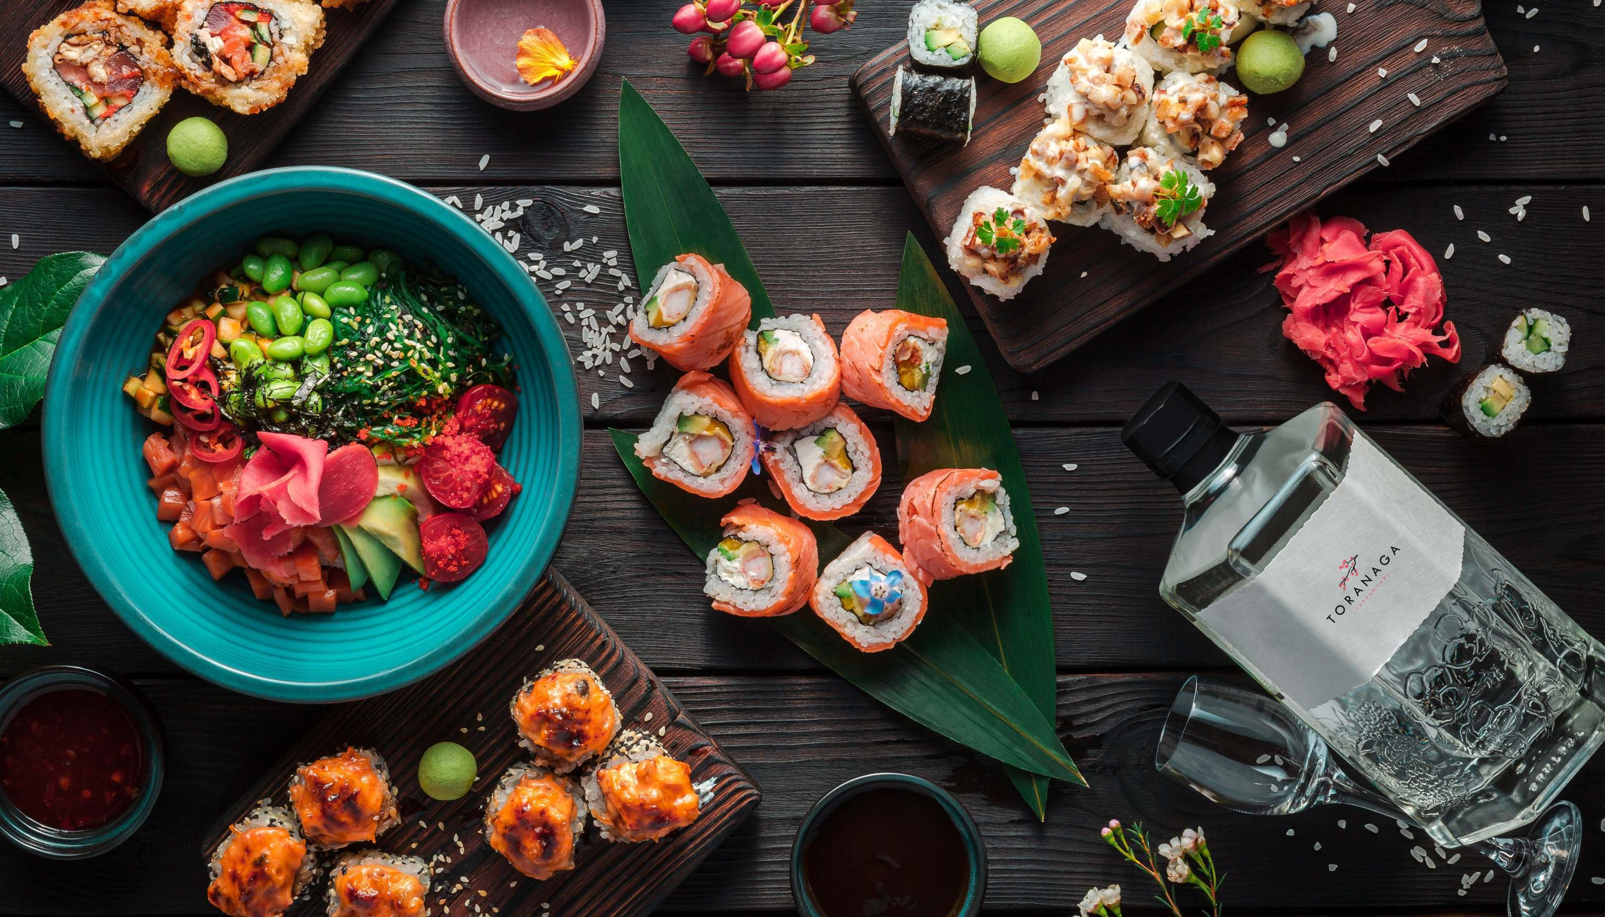
SUSHI RESTORANI
19꞉00-22꞉00
“Extra”

Slide 18
WORKING HOURS
SERVICE TYPE
SERVICE
NOTES
 | Breakfast | 07꞉00‑10꞉00 | OPEN BUFFET | Kıyafet kuralı zorunludur.
MAKI | Late Breakfast | 10꞉00‑11꞉00
MAIN RESTAURANT | Lunch | 12꞉30‑14꞉30
 | Dinner | 19꞉00‑21꞉30
7/24 NISK RESTAURANT |  | 7/24 | NIGHT SERVICE
SUNSET | Snack Lunch, Light Snack | 12꞉00‑16꞉00 | MENU | Feee Of Charge
FOOD COURTS
Snacks
12꞉00‑17꞉00
TAKE AWAY
Feee Of Charge
Bar
10꞉00‑18꞉00
CANDYLAND
Take Away
12꞉00‑17꞉00
SELF SERVICE
Extra Charge
PATISSERIE
Chocolate, cakes, cookies, desserts
11꞉00‑17꞉00
FOOD COURT
Feee Of Charge
CANDYTOWN
Drinks
12꞉00‑14꞉30
OPEN BUFFET
Feee Of Charge
RADIKA
TURKISH CUISINE STEAK HOUSE
Drinks
19꞉00‑22꞉00
A’LACARTE
Ön rezervasyon gerekli
Guest Relations Service ‑ For 7 nights stay free of Charge Dress code is required for Dinner

Slide 19
WORKING HOURS
SERVICE TYPE
WINTER CONCEPT
Services available between
28.03.2025 – 01.05.2025
SERVICE
NOTES
 | Breakfast | 07꞉00‑10꞉00 | OPEN BUFFET | Dress Code is required for Dinner.
MAKI | Late Breakfast | 10꞉00‑11꞉00
MAIN RESTAURANT | Lunch | 12꞉30‑14꞉30
 | Dinner | 19꞉00‑21꞉30
LOBBY BAR
7/24
Ultra All Inclusive drinks are served Free of Charge
7/24 NISK RESTAURANT
12꞉00‑16꞉00
MENU
Free
 |  |  | Serves as International A’la Carte Restaurant for dinner. Pre‑booking required with Guest Relations Service. For 7 nights stay free of Charge Dress code is required for Dinner
PATISSERIE | Chocolate, cakes, cookies, desserts | 12꞉00‑17꞉00 | Free
SNACK A’LA CARTE | Snack Lunch, Light Snack | 12꞉00‑16꞉00 | Free
HEATED POOL |  |  | HEATED ACCORDING TO WEATHER CONDITIONS
TENNIS COURTS
FITNESS CENTER
MINI CLUB
ARENA NIGHT CLUB |  |  | The Jupiter Hall is used depending on the weather conditions.

Slide 20
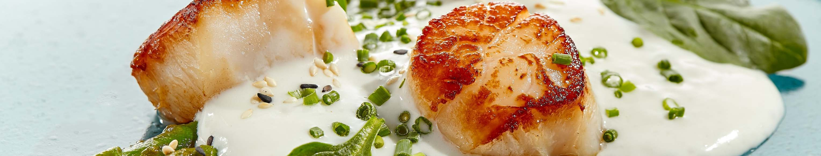
WORKING HOURS
SERVICE TYPE
SERVICE
NOTES
LOCO
ITALIAN CUISINE
Dinner
19꞉00‑22꞉00
A’LACARTE Pre‑booking required with
Guest Relations Service ‑ For 7 nights stay free of Charge Dress code is required for Dinner
MORALA SEA FOODS
Dinner
19꞉00‑22꞉00
A’LACARTE Pre‑booking required with
Guest Relations Service ‑ For 7 nights stay free of Charge Dress code is required for Dinner
RADIKA TURKISH CUISINE
Dinner
19꞉00‑22꞉00
A’LACARTE Pre‑booking required with
Guest Relations Service ‑ For 7 nights stay free of Charge Dress code is required for Dinner
BEACH RESTAURANT | Breakfast, Lunch, Dinner |  | A’LACARTE | Extra
TORANAGA TEPPANYAKI | Dinner | 19꞉00‑22꞉00 | A’LACARTE | Extra

Slide 21
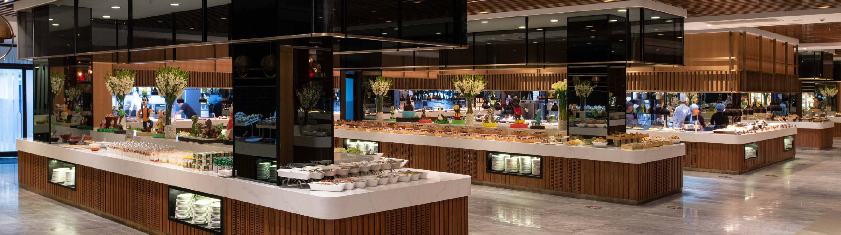
BARS | LOCATION | SERVICE | WORKING HOURS | TYPE | NOTES
Lobby Bar | Lobby | Beverage | 24 H | Bar | Ultra All inclusive drinks are served Free of Charge
Co ee House | Near the 7/24 Nisk | Beverage | 10꞉00‑22꞉00 | Bar | Fresh herbal teas and co ee
 | Restaurant
Pool Bar | Pool Side | Beverage | 10꞉00‑18꞉00 | Bar | Ultra All inclusive drinks are served Free of Charge
Candyland Bar | Candyland | Beverage | 10꞉00‑17꞉00 20꞉00‑22꞉00 | Bar | Soft Drinks, Ice Slush, Fresh Juice Extra of Charge
Candytown Bar | Candytown | Beverage | 10꞉00‑17꞉00 | Bar | Soft & Non alcoholic beverages Free Of Charge
 |  |  | 20꞉00‑22꞉30
Sunset Bar | Pool Side | Beverage | 10꞉00‑00꞉00 | Bar | Ultra All inclusive drinks are served Free of Charge
A La Carte Bar | Pool Side | Beverage | 10꞉00‑22꞉00 | Bar | Ultra All inclusive drinks are served Free of Charge
Service Bar | Main Restaurant | Beverage | 12꞉30‑14꞉30 | Bar | Ultra All inclusive drinks are served Free of Charge
 |  |  | 19꞉00‑21꞉30
Arena Bar | Cabaret | Beverage | 22꞉00‑01꞉00 | Bar | Ultra All inclusive drinks are served Free of Charge
Vitamin Bar | Spa Center | Beverage | 09꞉00‑19꞉00 | Bar | Fresh Squeezed Juices (some of Fresh Squeezed Juices are with extra charge)
Exclusive Bar | Vip Arena | Beverage | 09꞉00‑18꞉00 | Bar | Free just for Villa Guests Exclusive Club Serves
 |  |  |  |  | specialmade drinks and cocktails
Patisserie | Pool Side | Beverage | 10꞉00‑22꞉00 | Bar | Free of charge

Slide 22
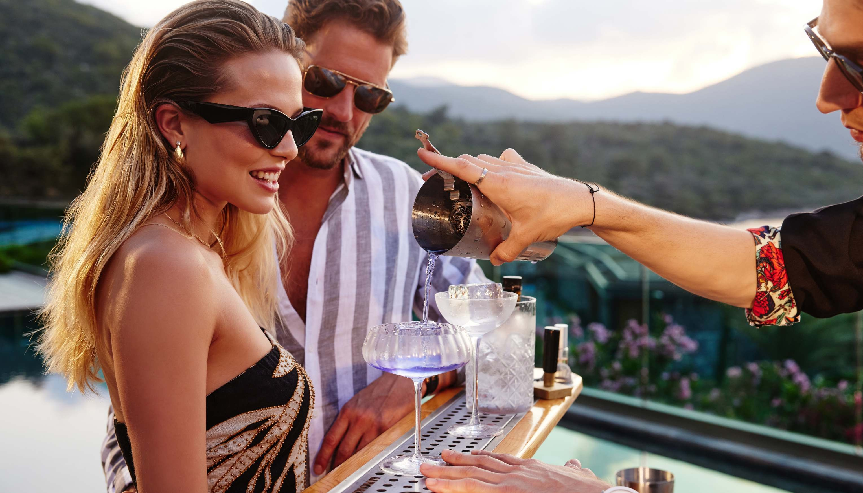
ALL DRINKS ARE WORLD BRANDS AND ORIGINAL PRODUCTS. BRANDS OF THE PRODUCTS MAY CHANGE DEPENDING ON THE CONCEPTS AND LOCATION OF THE BARS. À LA CARTE RESTAURANTS PROVIDE DINNER SERVICE BETWEEN 28.03.2025- 31.10.2025 OPENING DATES AND HOURS MAY VARY DEPENDING ON WEATHER CONDITIONS AND HOTEL OCCUPANCY. RESTAURANT DRESS CODE FOR DINNER꞉
CASUAL SMART ATTIRE IS REQUIRED FOR DINNER.

Slide 23
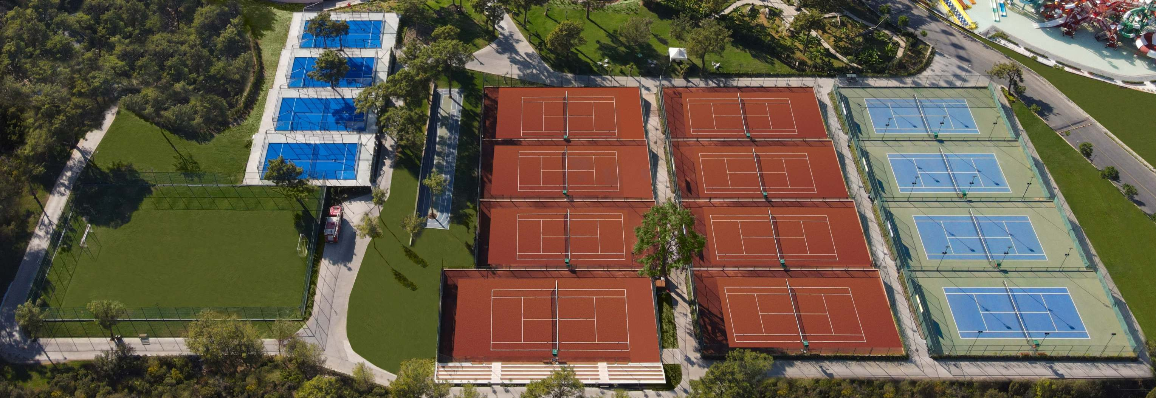

sport & activities
FREE OF CHARGE | Aquapark | LunaPark | Zumba | Dino Park | Table Tennis
4 Tennis Hard Courts | Beach Volleyball | Darts | Pilates | Aqua Gym | Yoga
2 Bassketball Courts | Pool Games | Kangoo | Step | Reformer | Tramboling
Fitness Center | Water Polo | Spinning | Kids Games
EXTRA OF CHARGE
Total 12 Tennis Courts ‑ 7 Clay Courts ‑ 1 Center Court ‑ 4 Padel Courts Tennis Lessons Game CEnter
Football (semi professional) 30x50m
Water Sports
Private Fitness Trainer
With 4 holes 350 m long having a driving range able for 9 games
Football and Tennis Court Lighting

Slide 24
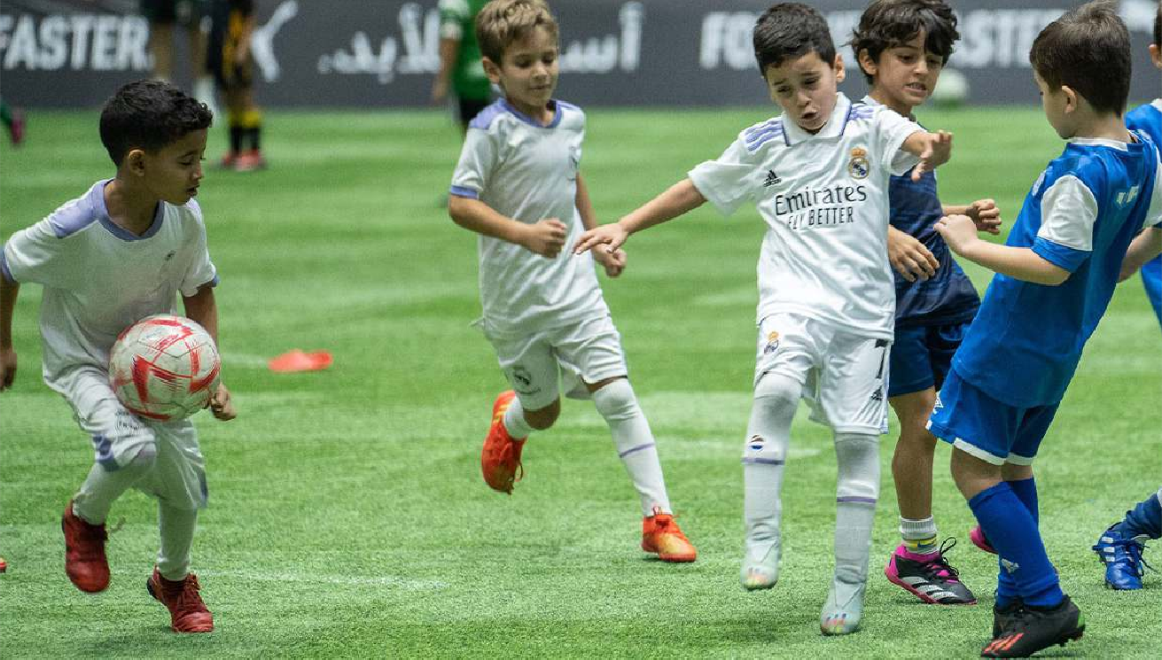
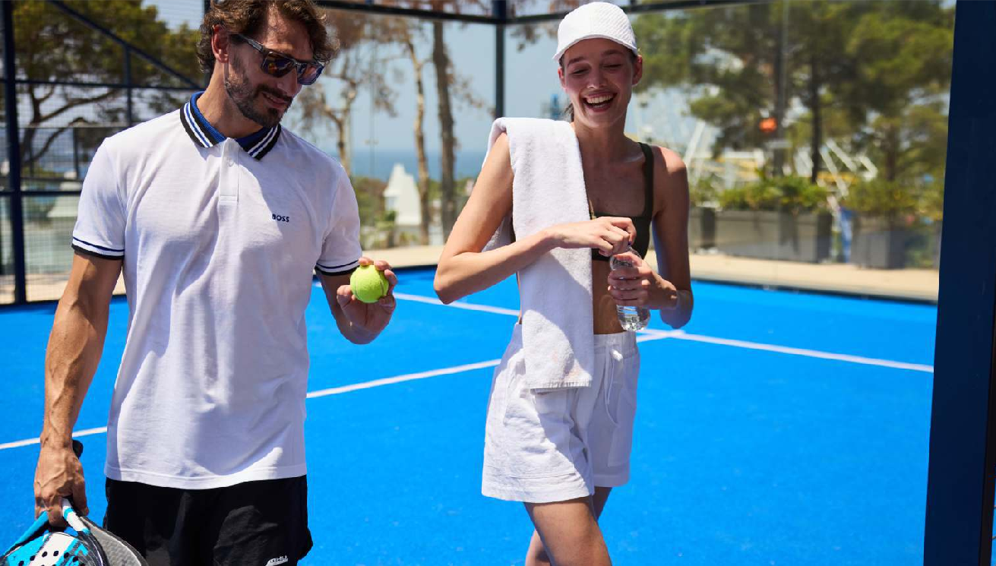
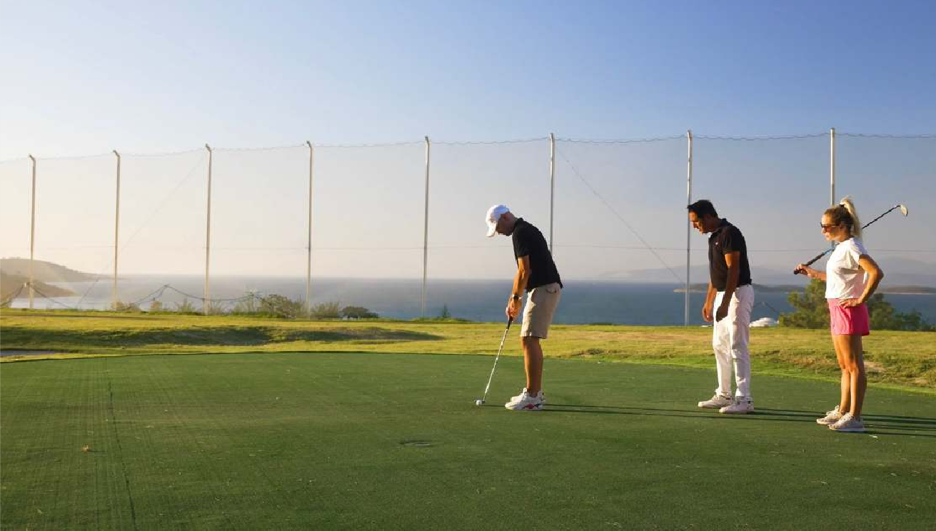
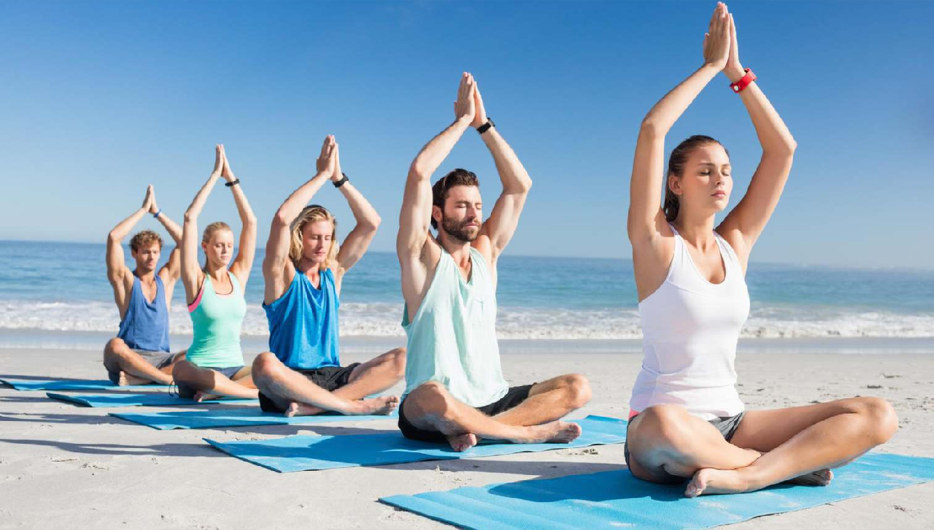

Slide 25
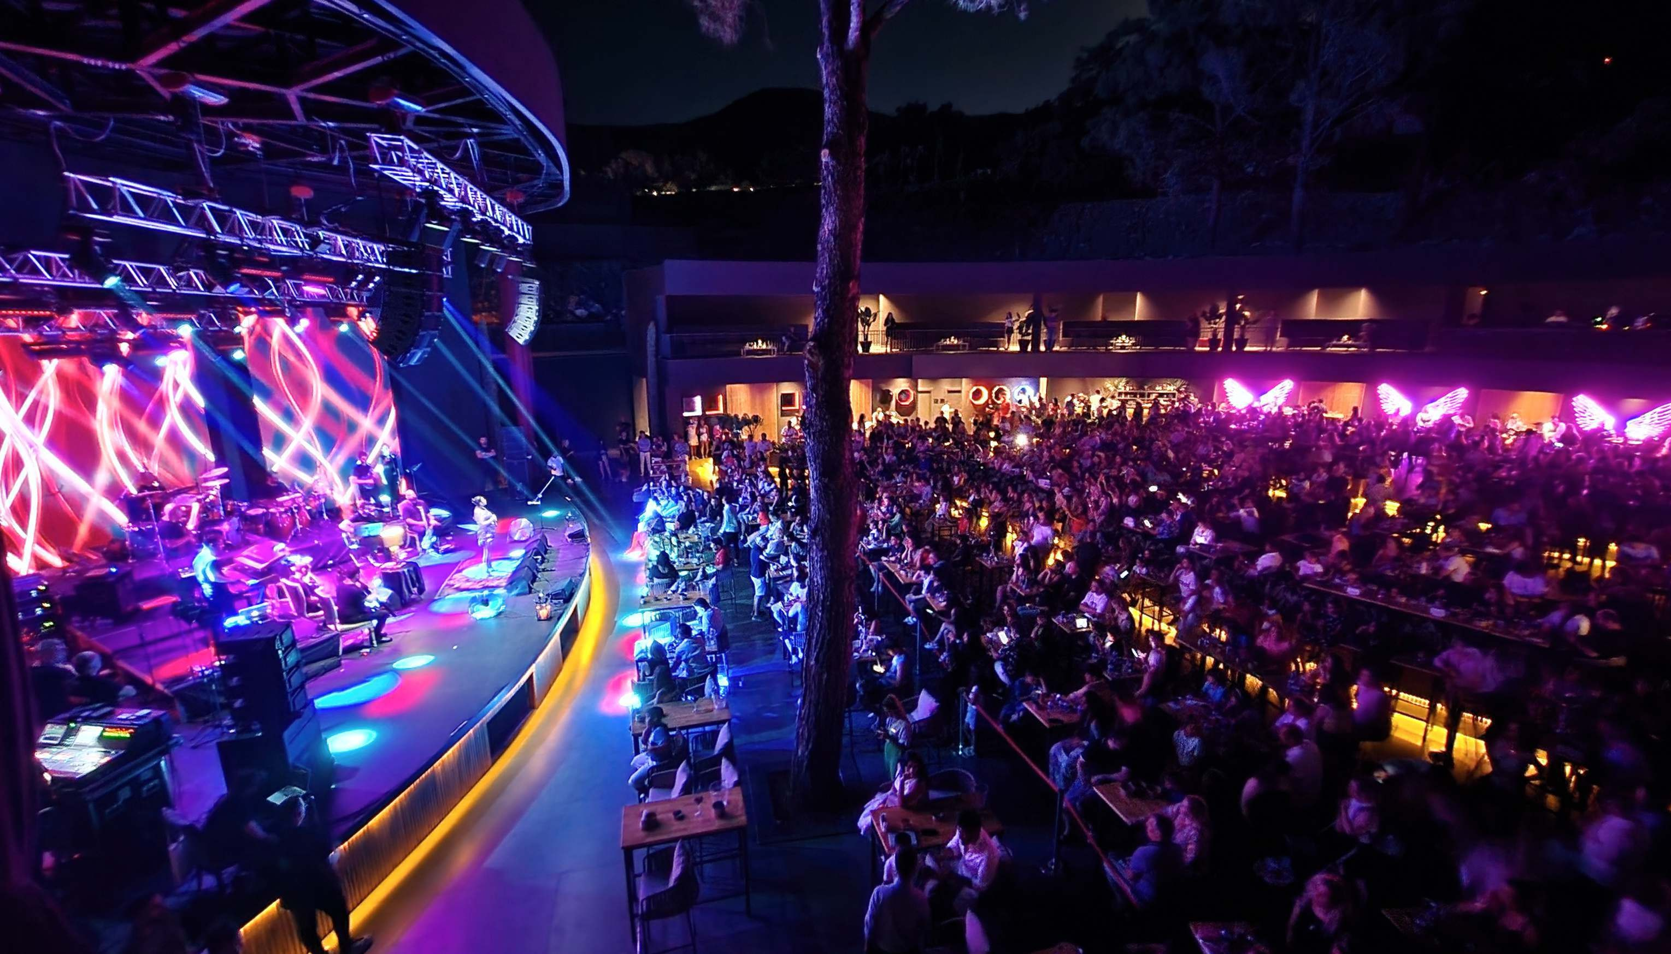
ENTERTAINMENT
Day & Night Beach Club, Cabaret, Disco, Theme Parties, Shows Programs, Daily Tournaments

Slide 26
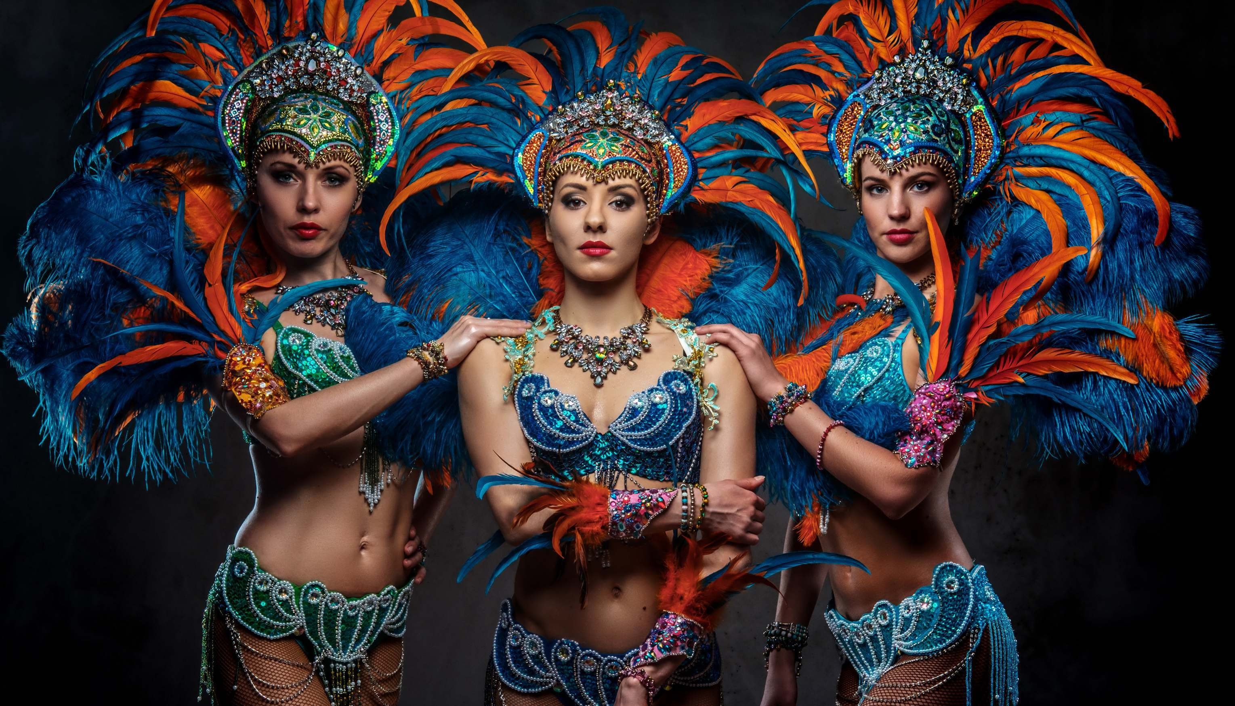

Slide 27
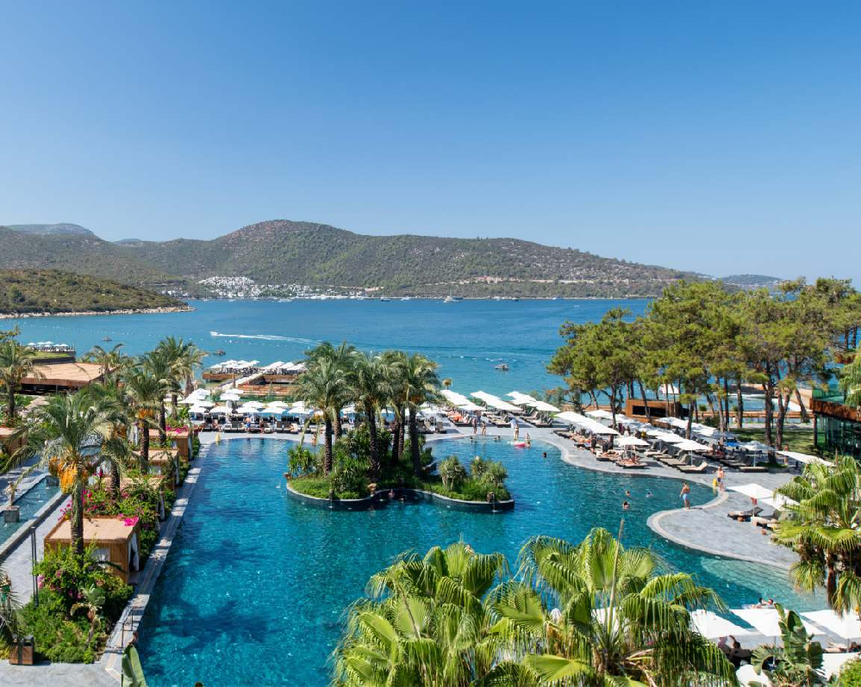
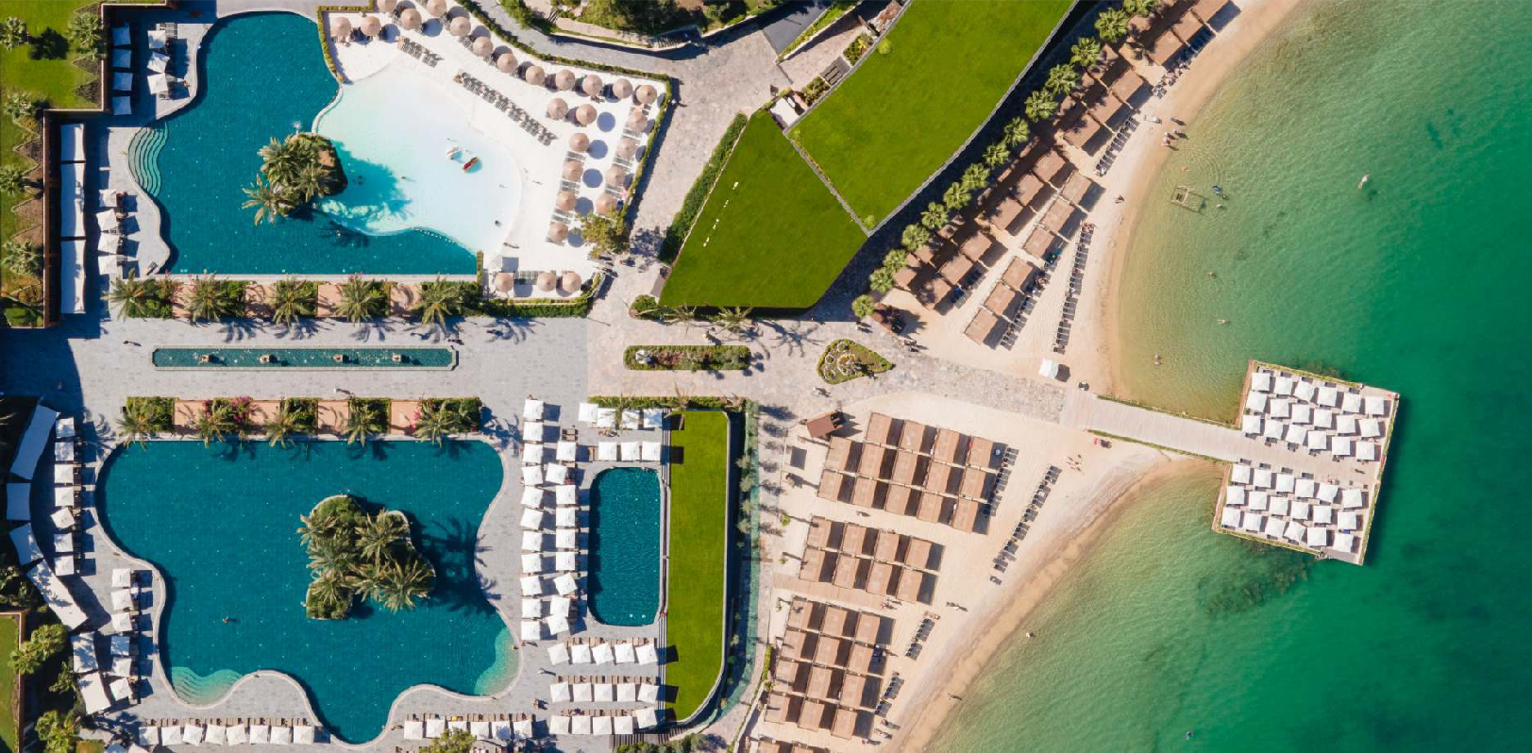
SWIMMING POOLS | MAIN POOL 1 | MAIN POOL 2 | RELAX POOL | CANDYLAND POOL | INFINITY POOL
Outdoor Pools
Kids Pools Heated Sweet Water | x x | x | x x | x
Area (m2) | 1253 | 850 | 585 | Total 7000 | 200
Maximum Depth (cm) | 1,40 | Adult꞉ 1,40 | 1,40 | Adult꞉ 1,40 Child꞉0,35 | 1,40
Sunbed
Umbrella / Tent
Beach Towel (Ne Deposit Required)
Shower | x | x | x |  | x
HEATED ACCORDING TO WEATHER CONDITIONS

Slide 28
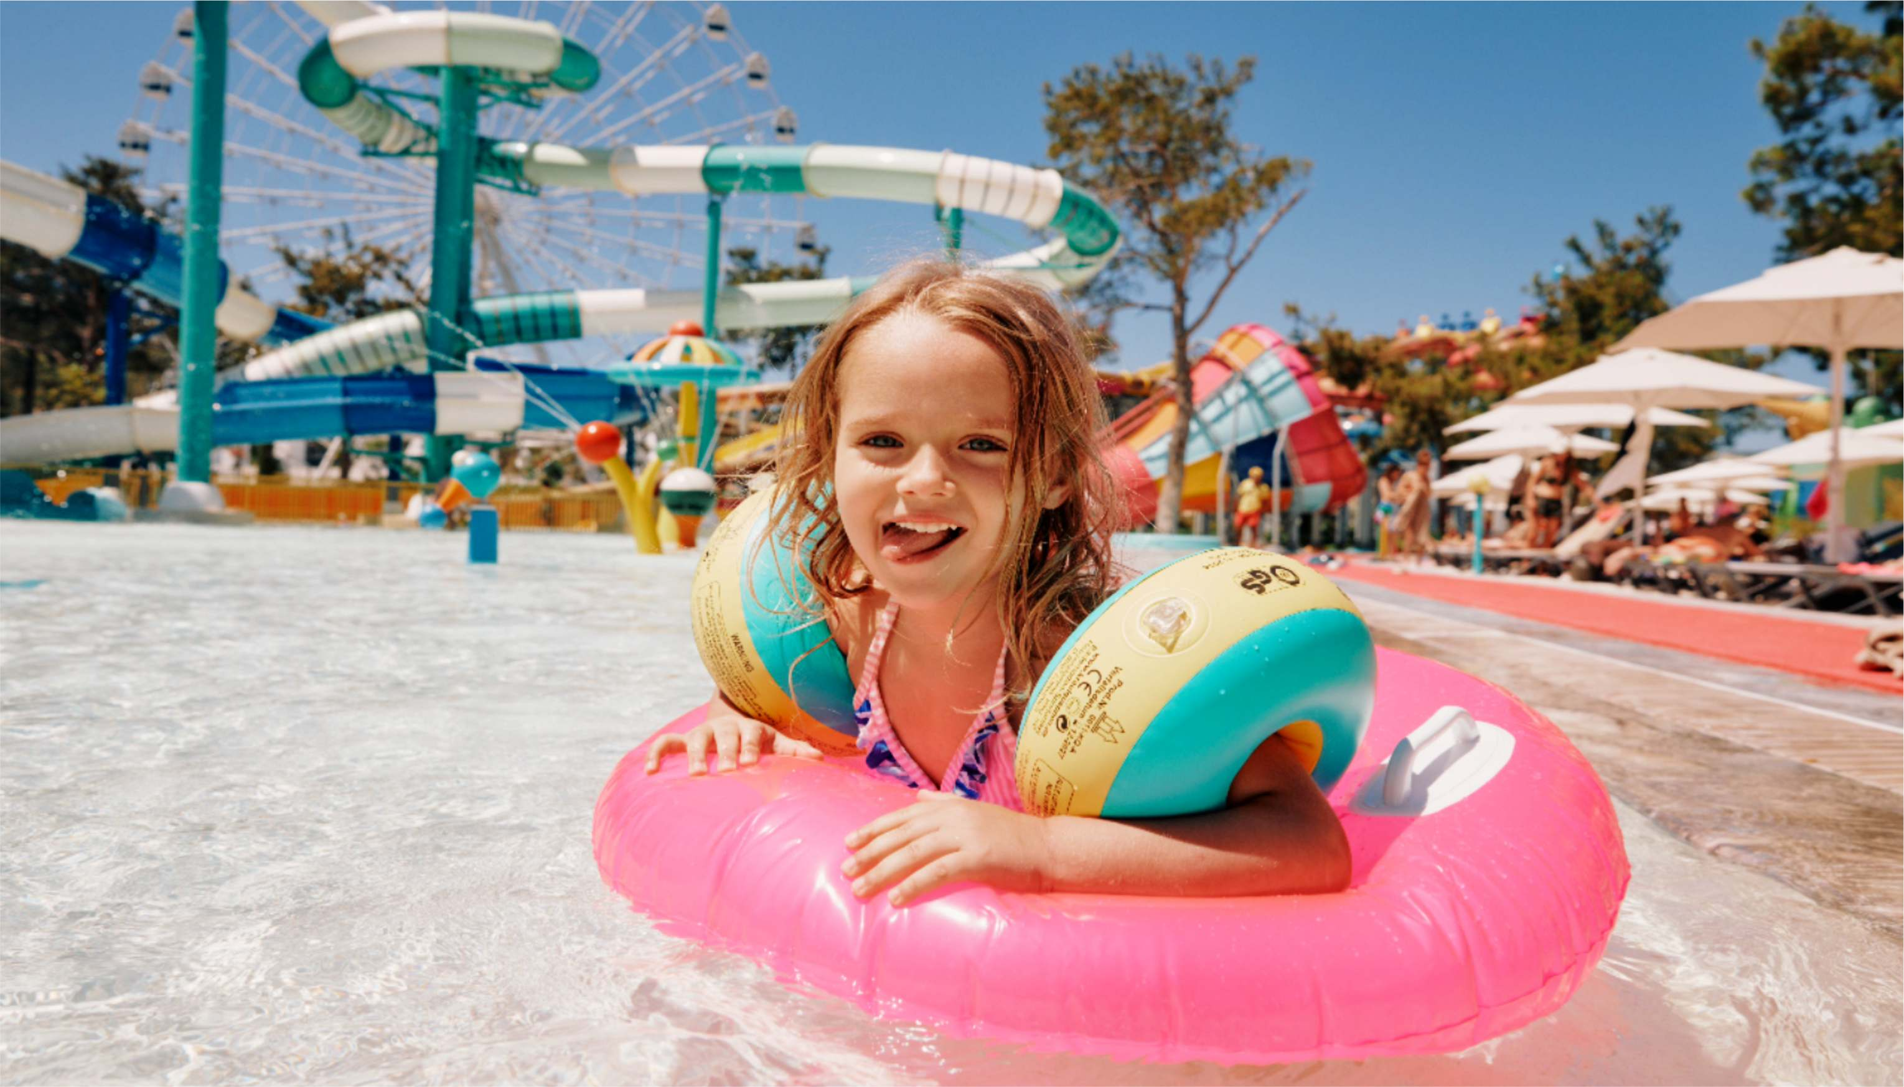

Slide 29



Slide 30
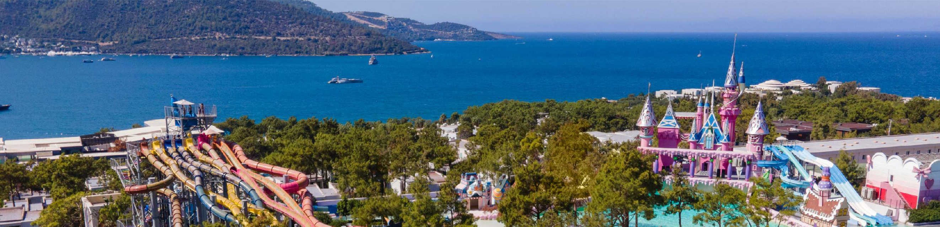
SLIDES
HEIGHT LIMIT
NOTES
Slides
Min. 1,20m
Min 120 kg Min 2 person
The total area of the Aqua Park is 15,000 square meters. Entrance to the Aqua Park is complimentary for hotel guests.
Storm Racer Max.320kg Max 4 person
Min.1,20m
Min 120 kg Min 2 person
Opening and closing dates 01.05.2025‑31.10.2025
Aquatower Multislide 1 Max.320kg Max 4 person
Aquatower Multislide 2 Min. 0.90m tall and above
There are a total of 28 slides.
Aqua Tower Aquatube 1 Min. 0.90m tall and above
Aqua Tower Aquatube 2 Min.1,20m Max.120kg
The depth of the Adult Pool is 120 cm. The Children's Pool has a depth of 40 cm.
Aqua Tower Aquatube 3 Min.1,20m Max.120kg
Aqua Tower Aquatube 4 Min.1,20m Max.120kg
Children under the age of 10 must be accompanied by their parents.
Aqua Tower Kompakt Slide 1 Min.1,20m Max.120kg
Aqua Tower Kompakt Slide 2 Min.1,20m Max.120kg
Food and beverage services within the park are available for an additional fee.
Aqua Tower Kompakt Slide 3 Min.1,20m Max.120kg
Aqua Tower Space Hole Min.1,20m Max.120kg
Loop Rocket Min.1,20m Max.120kg
For hotel guests, the kiosks located in the Aquapark offering fast food options such as hamburgers, pizza, doner and soft drinks, will be complimentary.
Min.1,40m Min. 35kg Max.120kg

Slide 31
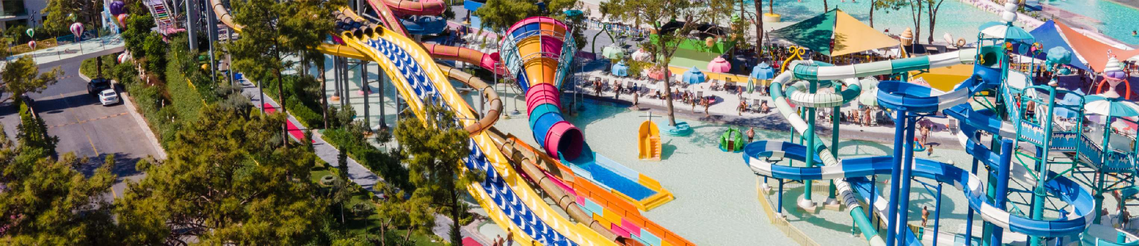
SLIDES
HEIGHT LIMIT
NOTES
King Cobra Min.1,20m
1 Kişi꞉ Min 60 kg ‑ Max 120 kg
The total area of the Aqua Park is 15,000 square meters. Entrance to the Aqua Park is complimentary for hotel guests.
Turbolance 2 Person꞉ Min 90 kg ‑ Max 180 kg
Min.1,20m
1 Kişi꞉ Min 60 kg ‑ Max 120 kg
Opening and closing dates 01.05.2025‑31.10.2025
Rafting Flying 2 Kişi꞉ Min 90 kg ‑ Max 180 kg
Min.1,20m
There are a total of 28 slides.
1 Kişi꞉ Min 60 kg ‑ Max 120 kg
Multi Slide (3 line) 2 Kişi꞉ Min 90 kg ‑ Max 180 kg
The depth of the Adult Pool is 120 cm. The Children's Pool has a depth of 40 cm.
Min.1,20m
1 Kişi꞉ Min 60 kg ‑ Max 120 kg
Children under the age of 10 must be accompanied by their parents.
Kamikaze 2 Kişi꞉ Min 90 kg ‑ Max 180 kg
Body Slide 1 Min.1,20m Max.120kg
Twister Racer (4) Min.1,20m Max.120kg
Food and beverage services within the park are available for an additional fee.
Aquatube Min.1,20m Max.120kg
Tunnel Free fall Min.1,20m Max.120kg
For hotel guests, the kiosks located in the Aquapark offering fast food options such as hamburgers, pizza, doner and soft drinks, will be complimentary
Kamikaze 5Tip Min.1,20m Max.120kg
Magicone Min.1,20m Max.120kg

Slide 32
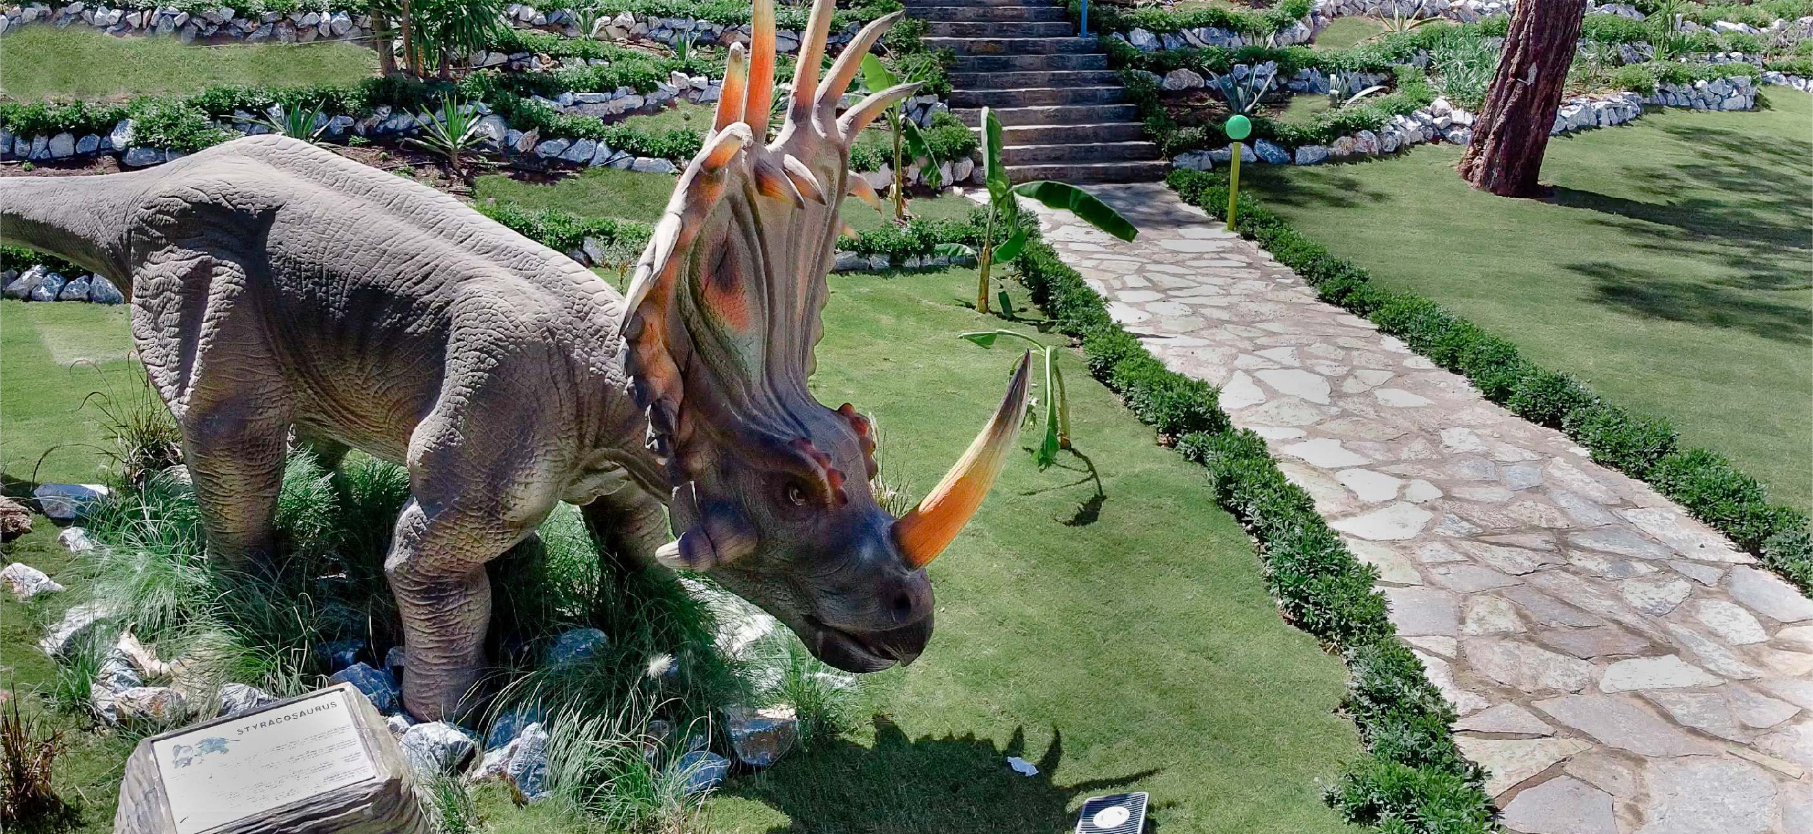
Candytown Dinopark
19 giant dinosaurs at Candyland bring the thrill of the past to the present! They’re waiting to welcome little visitors and their parents between May 1, 2025, and October 31, 2025

Slide 33
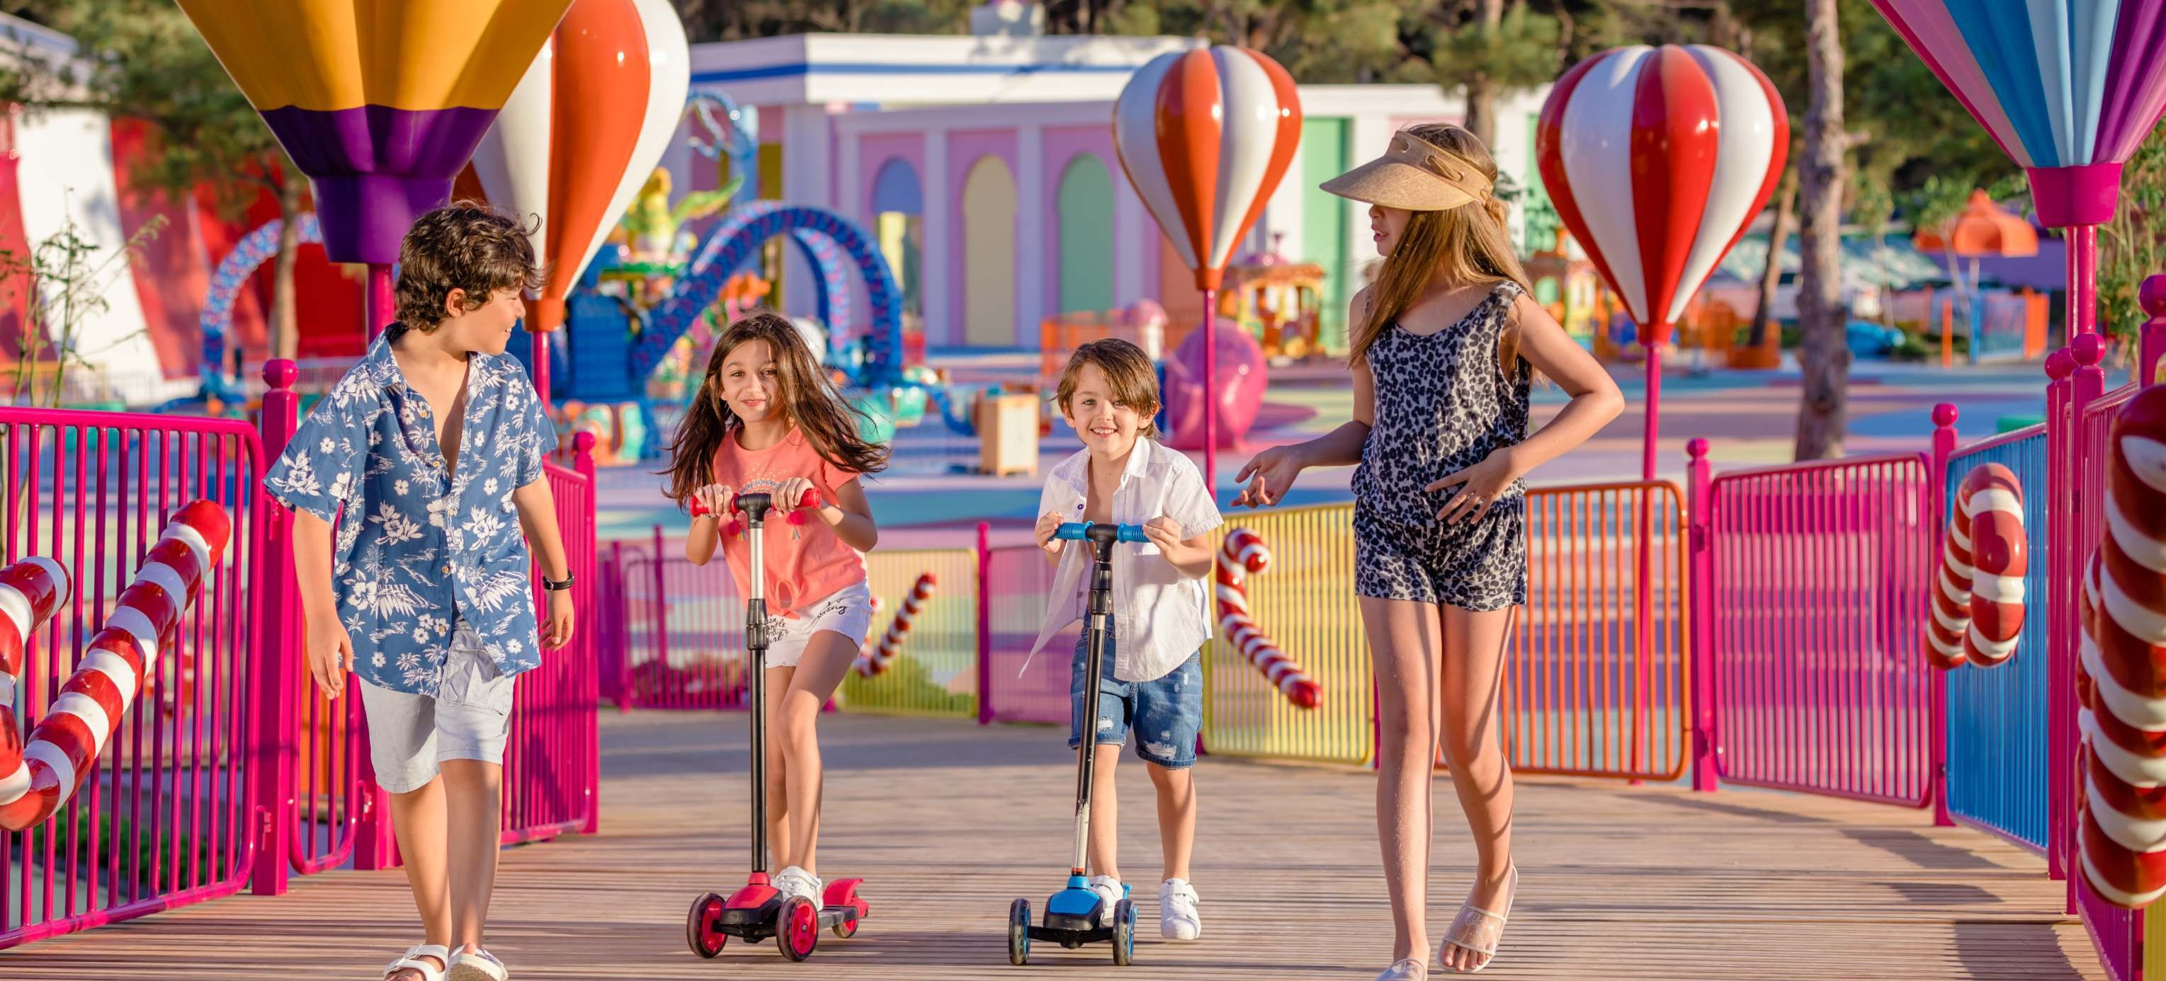

MINI CLUB 4‑7 YEARS
Outdoor Candytown Kids Club is opened 28.03.2025 – 31.10.2025*
Out of this dates Mini club will operate in the main building. Kids Club is situated on 5000 m2. Designed as mini city with theater, PS room, cinema, dance room, teenager club, 0‑3 years old room Baby Room (0‑3 years) children should be supervised by their parents
TEENAGE CLUB 8‑14 YEARS
Individual babysitting service between 18꞉00 ‑ 00꞉00 (paid service

Slide 34
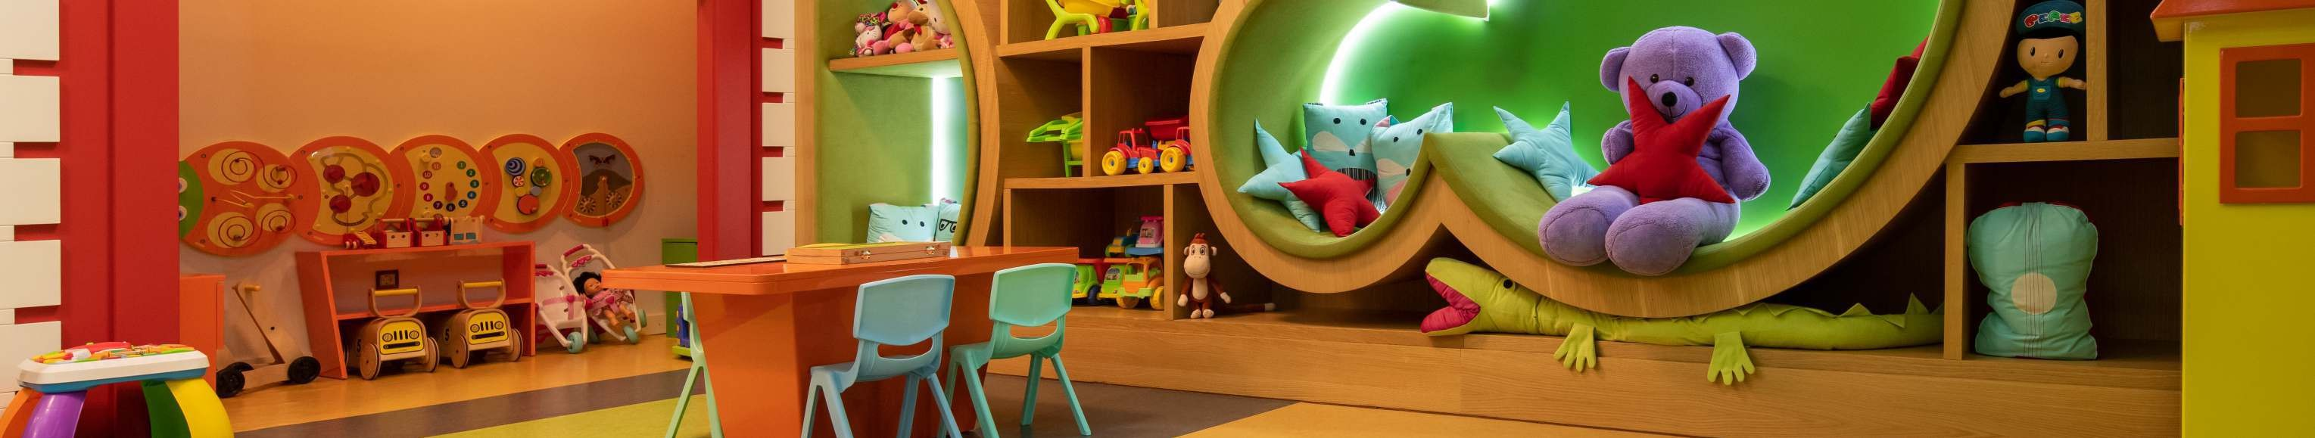
AGE GROUP FOR MINI CLUB 4‑7
Kids Fitness | Discovery Nature | Play Dough | Wild West
Kinetic Sand | Origami | Creating Masks | Treasure Hunting
Fire Fighters | Artcraft | Kids Yoga | Olympic Games
Mini Disco | Cooking Workshop (Masterchef) | Outdoor Playground | The Laboratory Day
Acyrilic Workshop | Baloon Workshop | Basket Games | Kite Fest
Braslet & Naclet | Face and Body Painting | Mega Bubbles | Ebru Art
Table Games | Face Mask | Candy Factory | Ceramic Workshop
Ghost | Judo | Memory Games | Quest Games (Jumanji,Madagaskar…)
Dino Day | Greenhouse Study | Roboting Codng | Birthday Party (Extra Charge)
AGE GROUP FOR TEENAGE CLUB 8‑14
Activity Room | Boccia | Mini Stage Music Corner | Play House
Balloon Rally | Quest Games (Jumanji,Madagaskar…) | 3D Cinema / Movies | Face and Body Painting
Water Polo | Water Olympic Games | Ceramic Workshop | Fun Starts
Greenhouse Study | Playstation 5 Room | Table Tennis | Basketball
Football | Ebru Art | Evening Shows | Table Tennis Tournament
Treasure Hunting | Basketball | Party | Volleyball
Origami | Pool Games | Creating Necklace & Wristbands | Candy Factory
Table Games | Roboting Coding | Silence Cinema | Birthday Party (extra Charge)
Quest Games (Jumanji,Madagaskar…) | Ghost | Olympic Games

Slide 35
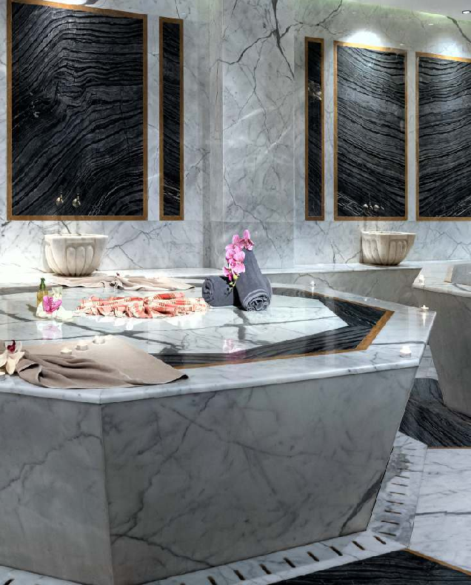
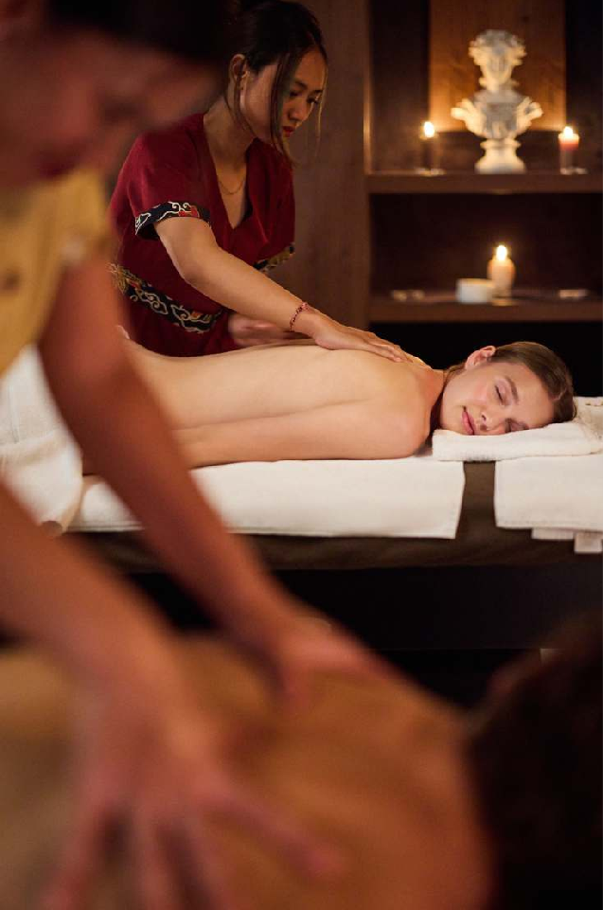
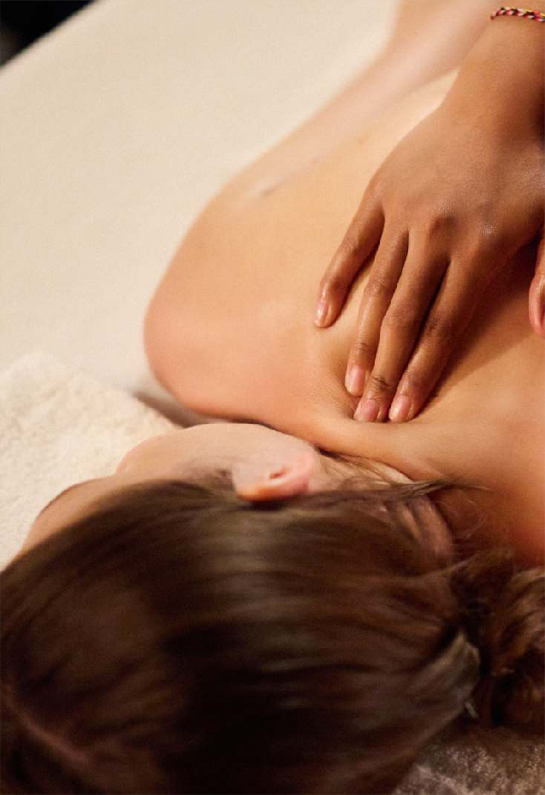
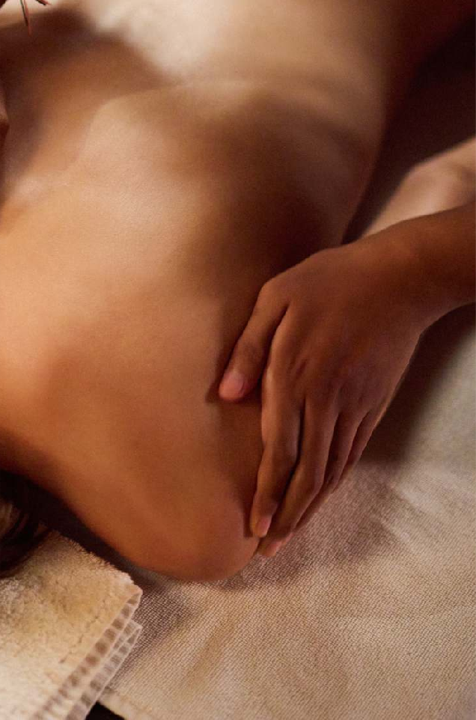

SPA & WELLNESS, 3000m2
OPERATING HOURS | 08꞉30‑20꞉00
Spa Reception and Greeting Service | Fitness Center | Shock Pool | Sauna | Vitamin Bar
Ayurveda Massage and Treatments* | Beauty Center | Far East Massages and Treatments | Natural Rituals & Spa Bathes* | Hairdresser*
Skin Care & Treatments* | Steam Room | Locker rooms for men and women | Turkish Sauna and Bath | Relaxing Area
*Treatments, massages and hairdresser service are chargeable

Slide 36
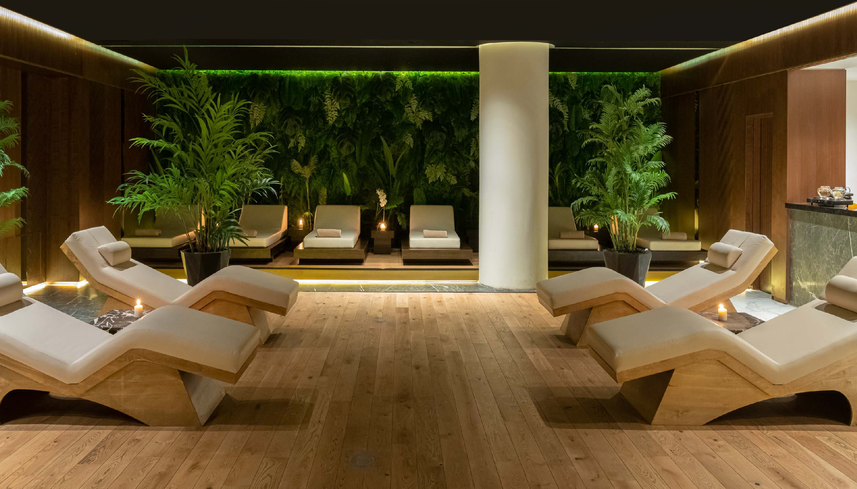

Slide 37
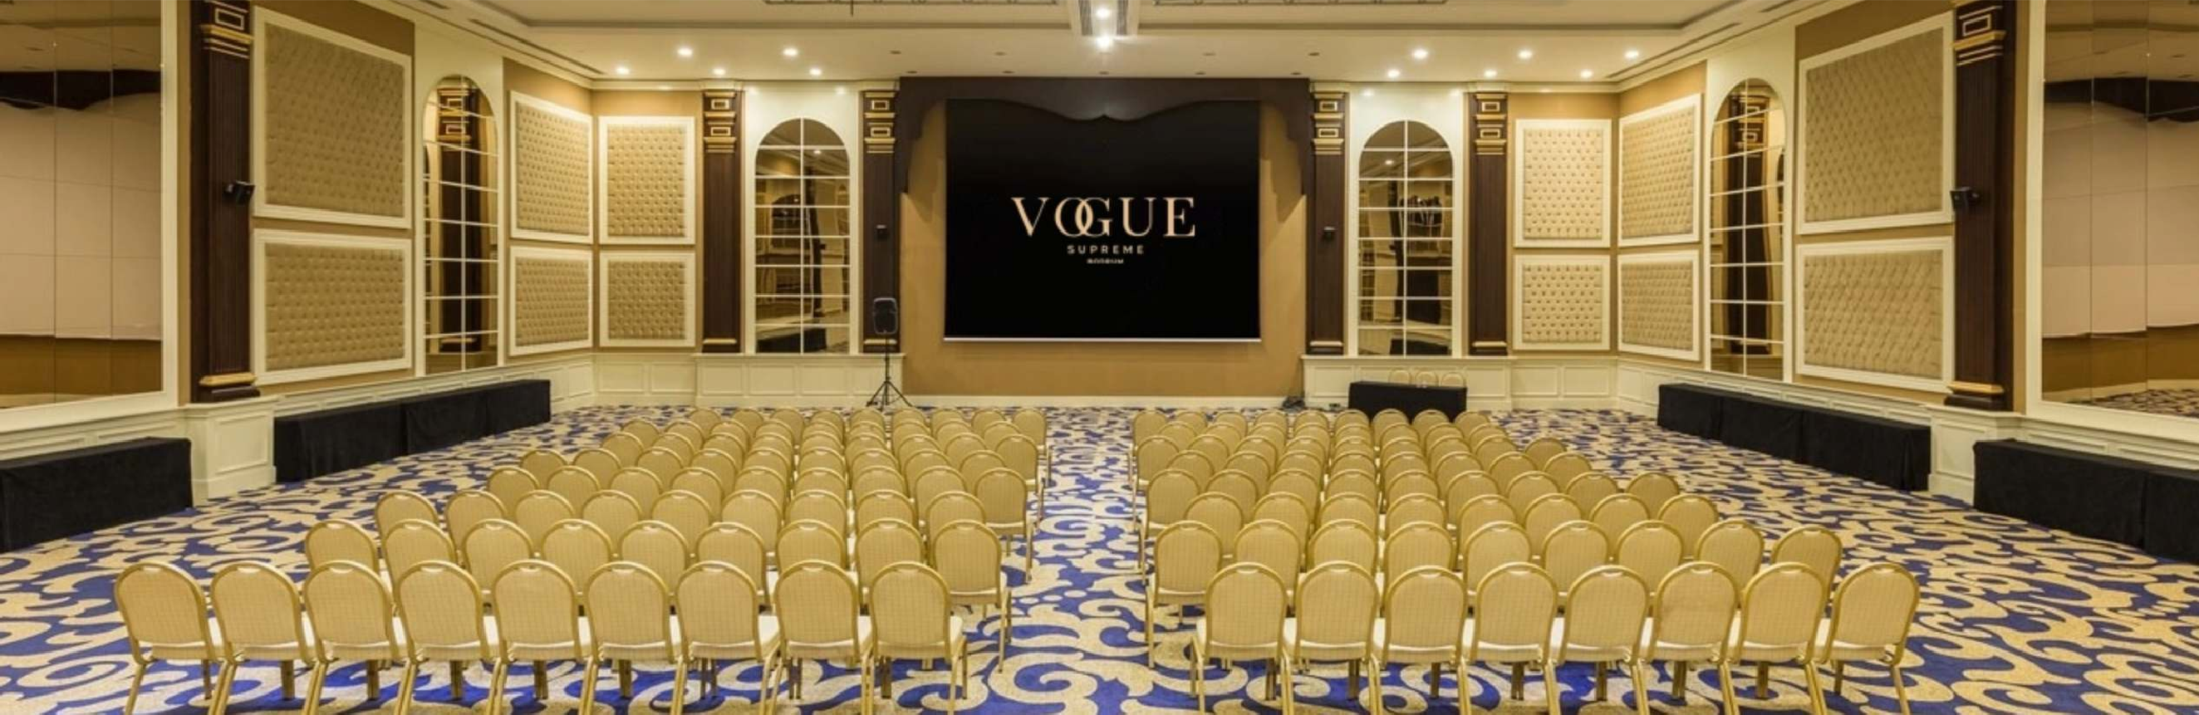
meeting & congress Area/M |  | Width | Lenght | Height | Theatre | Class Room | Banquete | Meeting | U Table
NEPTUNE | 80m2 | 8m | 10m | 3.60m | 40pax | 20pax |  | 20pax | 25pax
URANUS | 170m2 | 10m | 17m | 3.60m | 80pax | 40pax | 50pax
JUPITER | 400m2 | 19m | 21m | 6.50m | 350pax | 220pax | 250pax | 80pax | 100pax
*For special request please contact꞉ sales@voguehotelsupreme.com
Meeting & Congress related services / Equipment꞉
Free of Charge | Rostrum | Lectern microphone | Flipchart | High Speed Internet
Extra Charge | High Speed Internet | Co ee Break & Cookies | Sound system | Additional barcovision & barcovision curtain

Slide 38
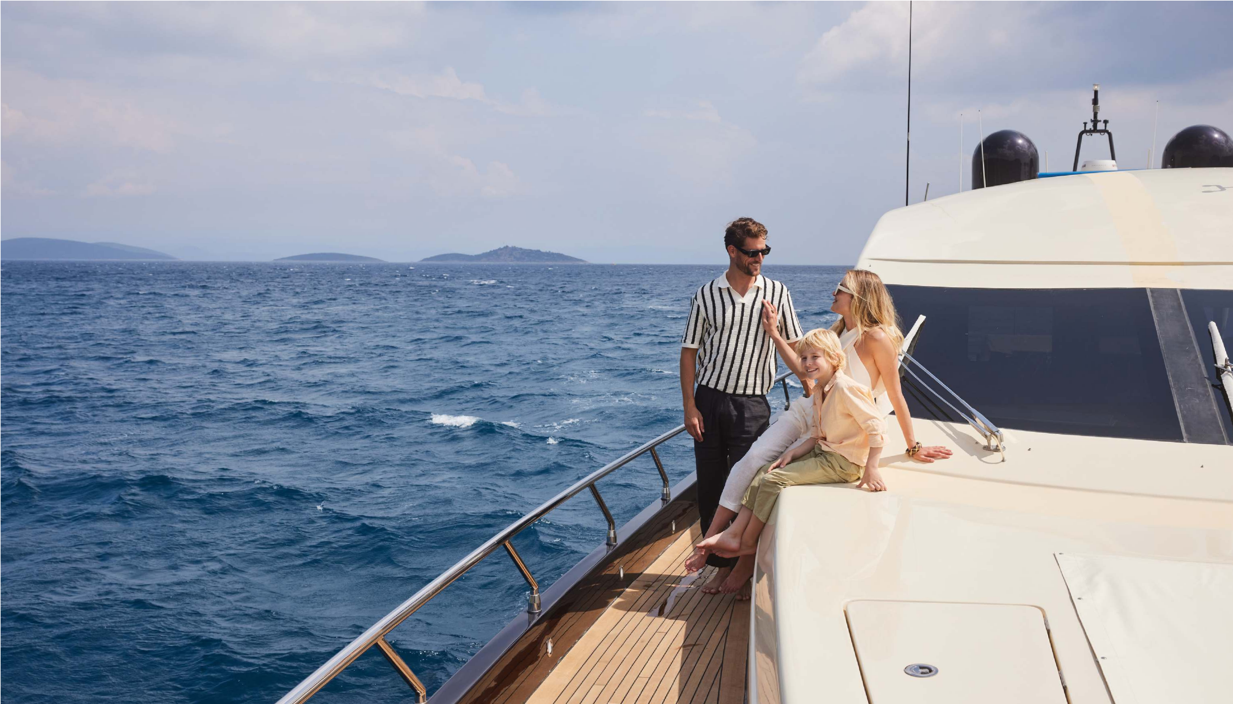







Brands

Slide 39
REMARKS
Smoking and water pipe are not allowed in indoor arears as per Law 4207 on Tobacco and Tobacco products.
Service of alcoholic beverages in all restaurants and bars is done with glass. All drinks that are served have import permits by the Customs Office. Brands involved in the contents concept shall be replaced with the original equivalent products in case of troubles with the Customs.
Outdoor units, and entertaining programme time schedule and location may vary depending on the weather conditions, or may be cancelled if needed. Any information about the hotel for publication in the mass media (catalogs, magazines, internet, etc.) must be preliminary agreed
with the hotel management, otherwise the hotel is not responsible for its reliability.
The hotel management reserves the right to modify, alter, cancel the facility information or otherwise change the site(s). Operating hours may be changed due to the weather conditions and Vogue Hotel Supreme Management
Indoor parking available with 10 USD daily fee, outdoor parking is available
2025
factsheet

Slide 40
